Slide 1

PGP In Project Engineering Capstone Project
Group 3 – Secure Payment/Order Confirmation/Real-time Inventory update & Shipping and Delivery
15-Dec-2023

Slide 2
Agenda
Team introduction
Capstone Project overview
Capstone Project solution design & solution implementation
Technology Stack
Challenges & errors encountered during solution design
Learnings & enhancements
Future Scope
Demo

Slide 3

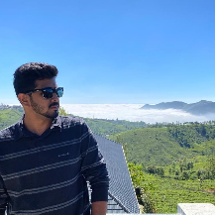
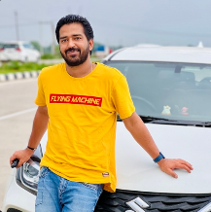
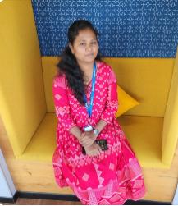
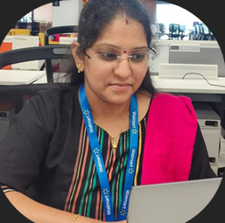
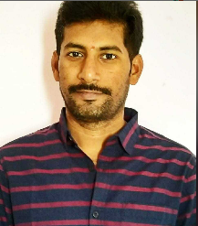

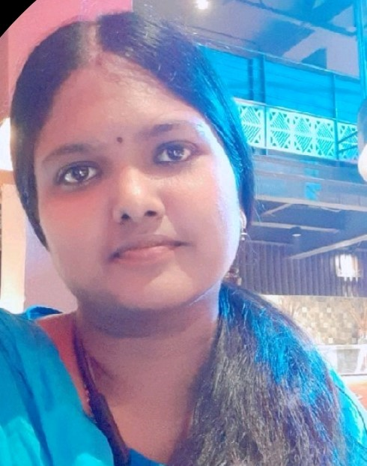
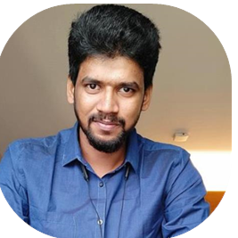
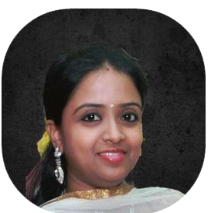
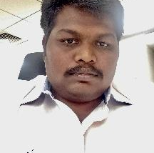

Team introduction
Team 6
Lingaraj Maddi Kamaraj
Prashanth Anand
Prashant Singh
Priyanka Sukumar
Radhika Kondavaram
Tirumalasetty Koteswara Rao
Team 7
NagendraKumar Renga
Shanthana S Shanthi
RajeshKumar MohanKumar
Sharmili Mahesh
Gunasekar M
S Ramakrishnan

Slide 4
Capstone Project overview
Wall E Cart is an online shopping platform that allows users to browse, select and purchase products from various categories.​
The platform aims to provide seamless shopping experience for customers and streamline the post transaction process for administrators
Group 3 Overview:
We are responsible for Secure Payment, Order Confirmation, Real-time inventory updates, shipping and delivery.
Team 6 handles below functionalities -
Secure Payment
Digital Wallet
Authentication through OTP to user email-Id
Cash On Delivery
Order Confirmation
Unique Order-Id generation
Email Notification - User receives email with Order details and Feedback link
Shopping Feedback - User can provide overall experience through given feedback link in email
Real-time Inventory Updates
Inventory gets updated in real time to prevent overselling of products that are out of stock
Team 7 handles below functionalities -
ADMIN UI
ADMIN should be able to add various shipping rules and associated shipping cost through UI Page.
Shipping & Delivery
Various Shipping Options to be displayed during check out (Standard, Express, same-day Delivery)
Each Cart calculate and provide Optimal Delivery date and shipping cost.
Order Confirmation and Tracking status mail till order is received successfully by user.

Slide 5
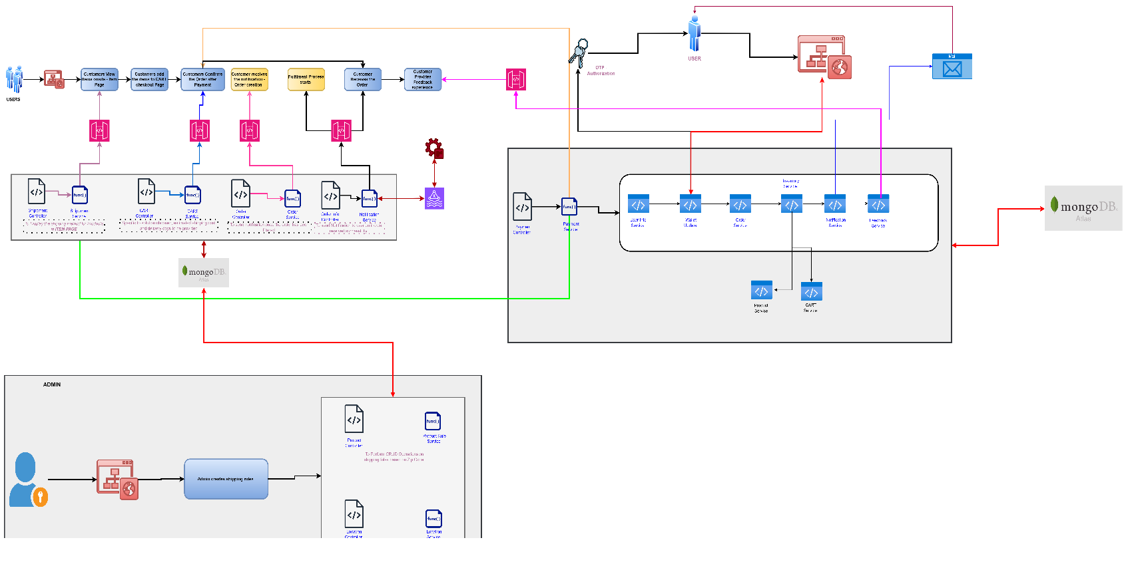
Capstone Project solution design
Architecture – GROUP 03

Slide 6
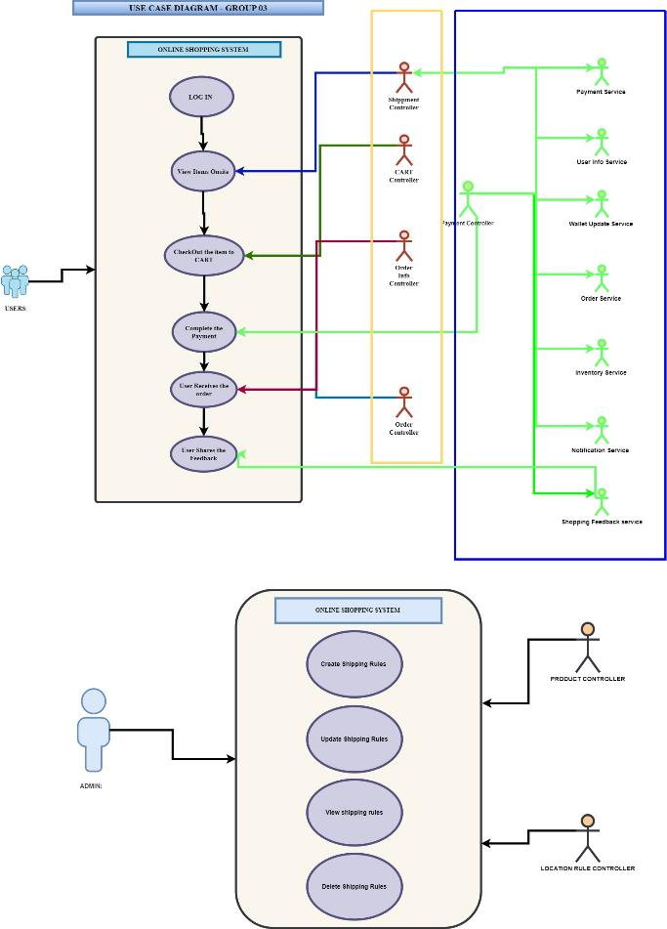
Use Case – GROUP 03

Slide 7
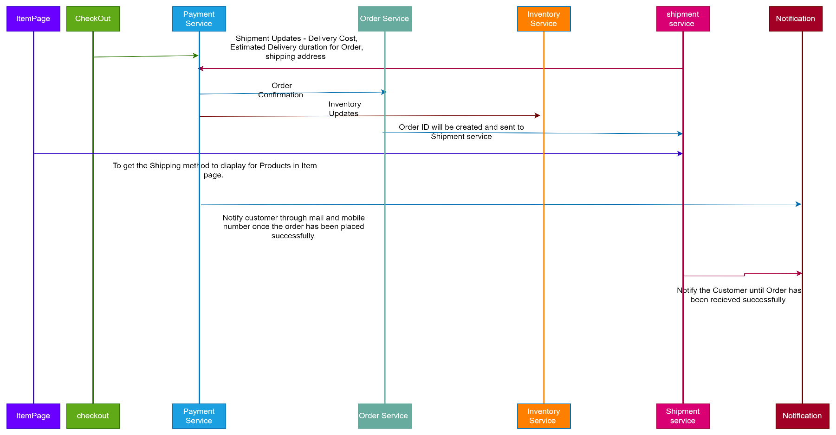
Service Calls – GROUP 03

Slide 8
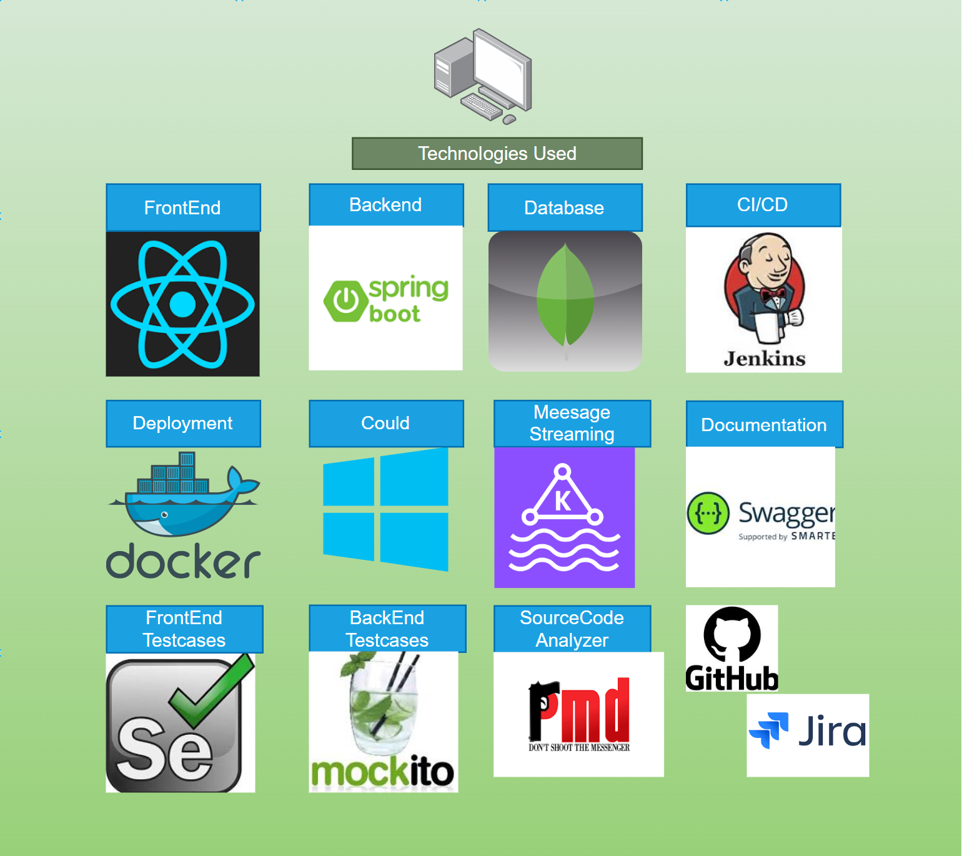
Technology Stacks

Slide 9
Team 6 – Secure Payment, Order Confirmation,
Real-time Inventory update

Slide 10
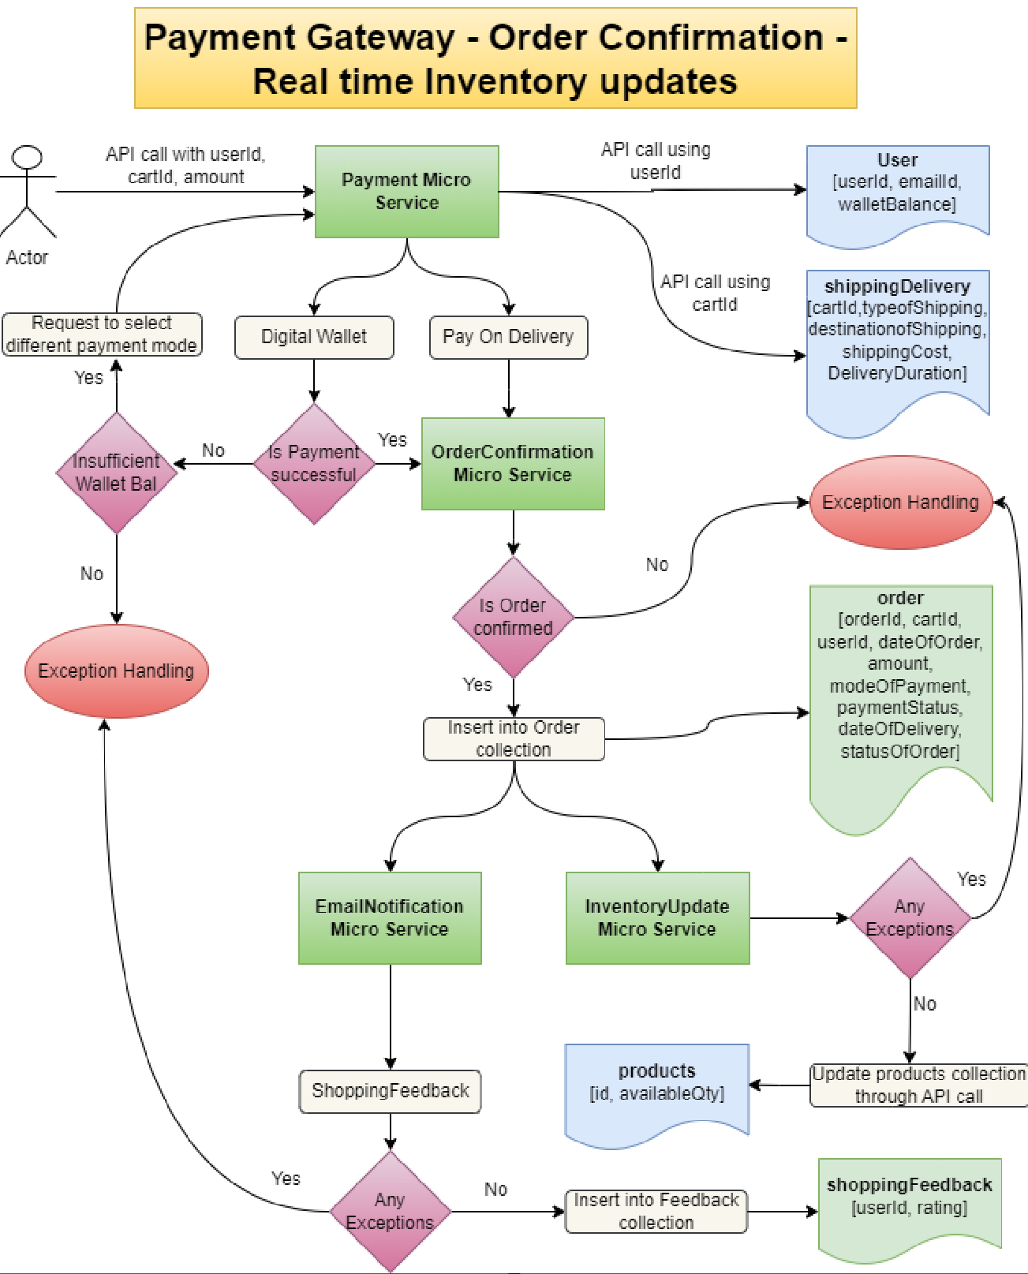
Capstone Project solution design

Slide 11
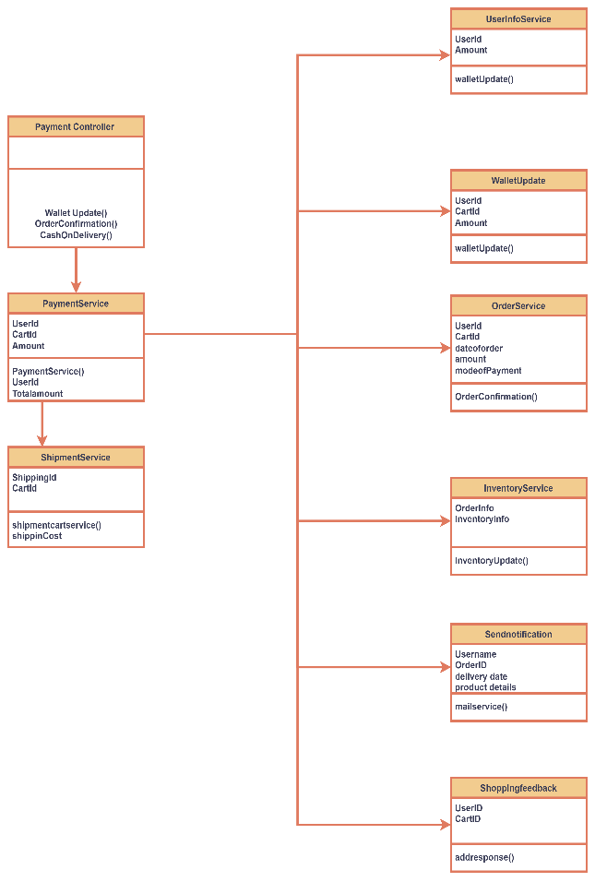
Class diagram

Slide 12
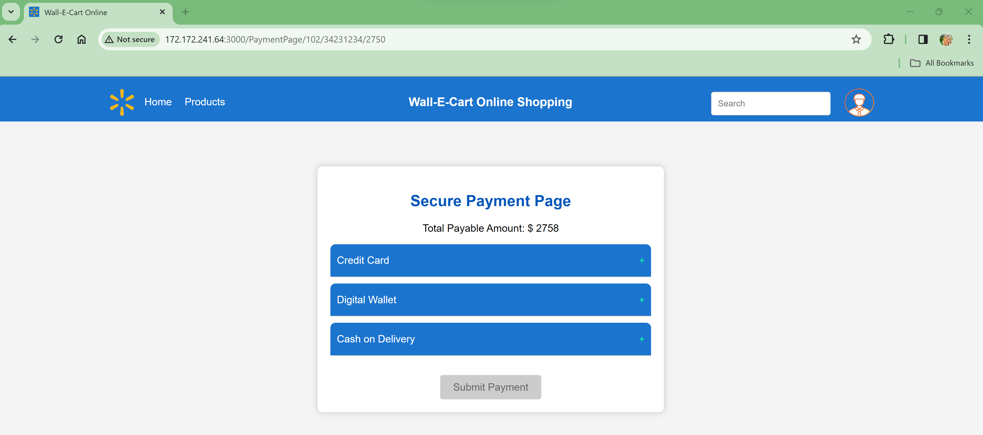
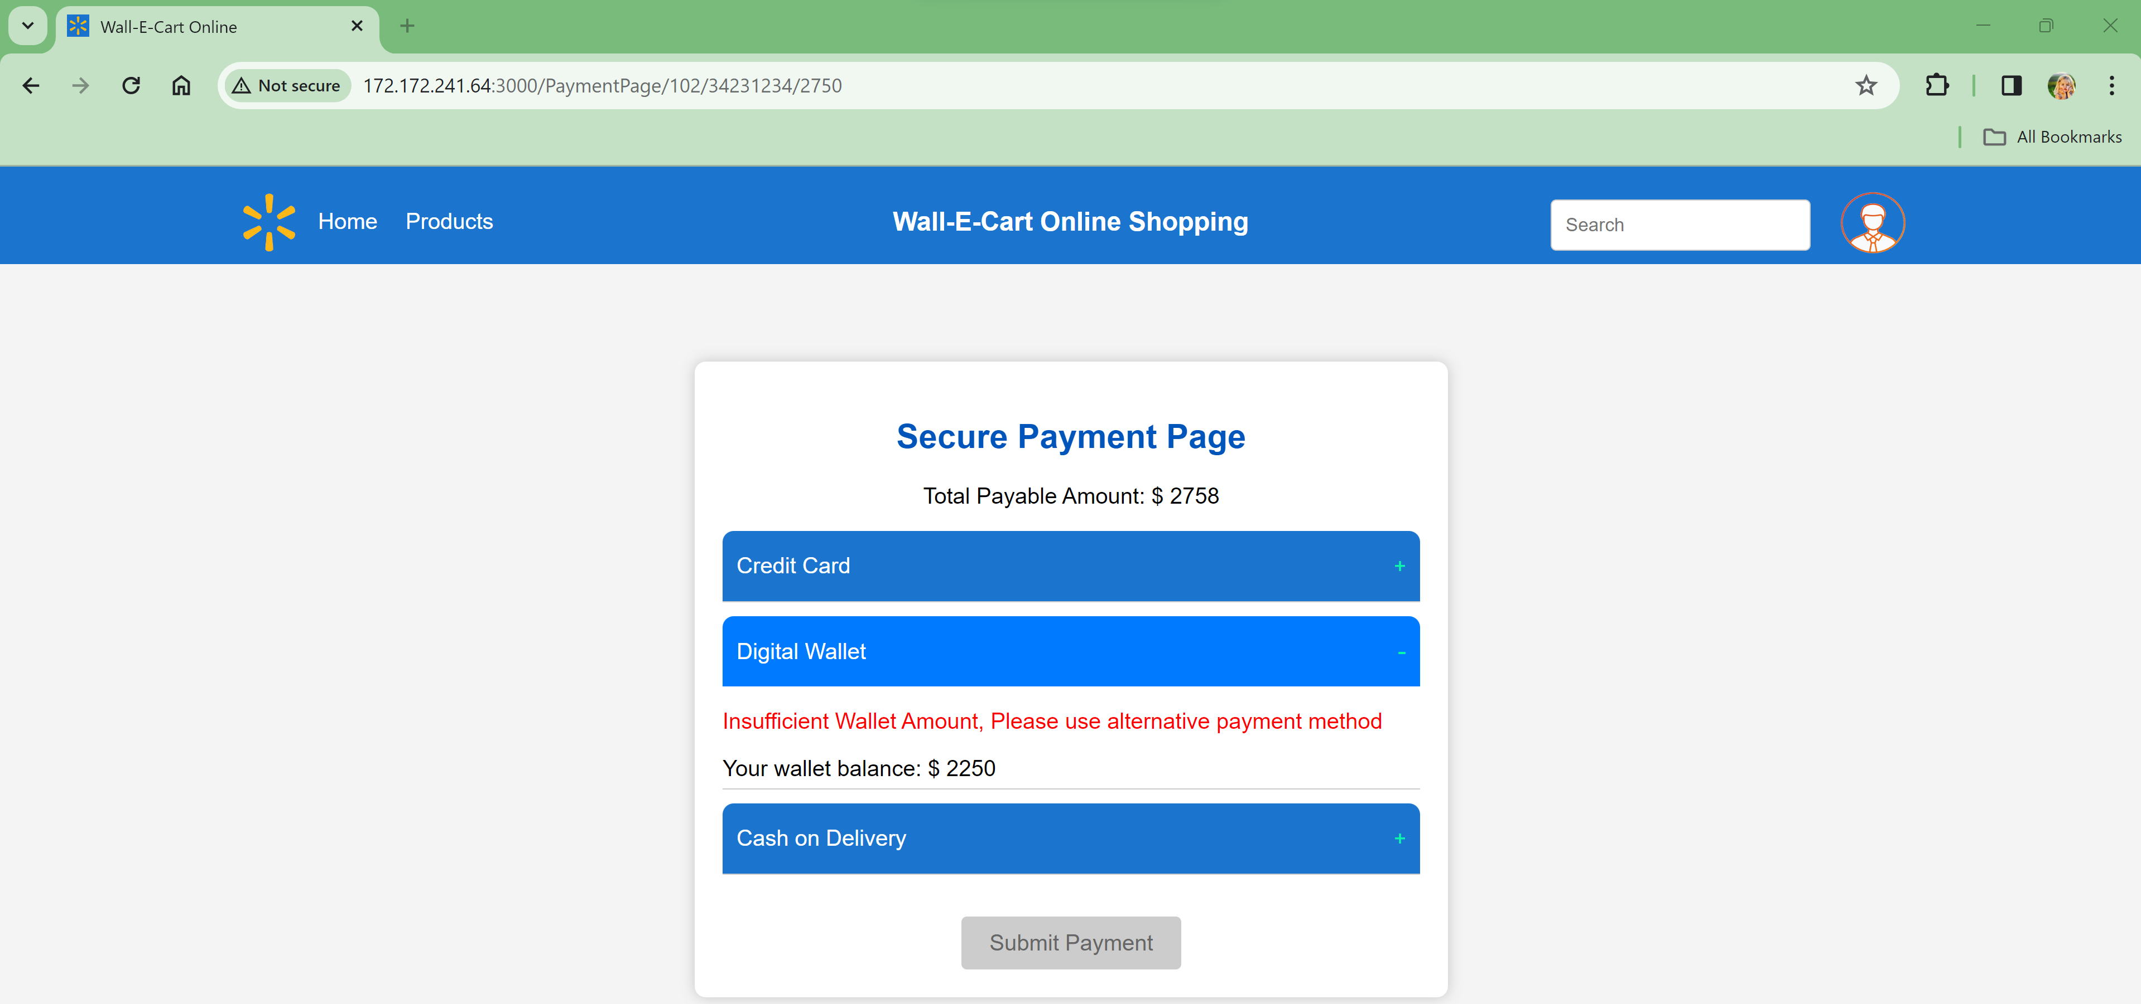
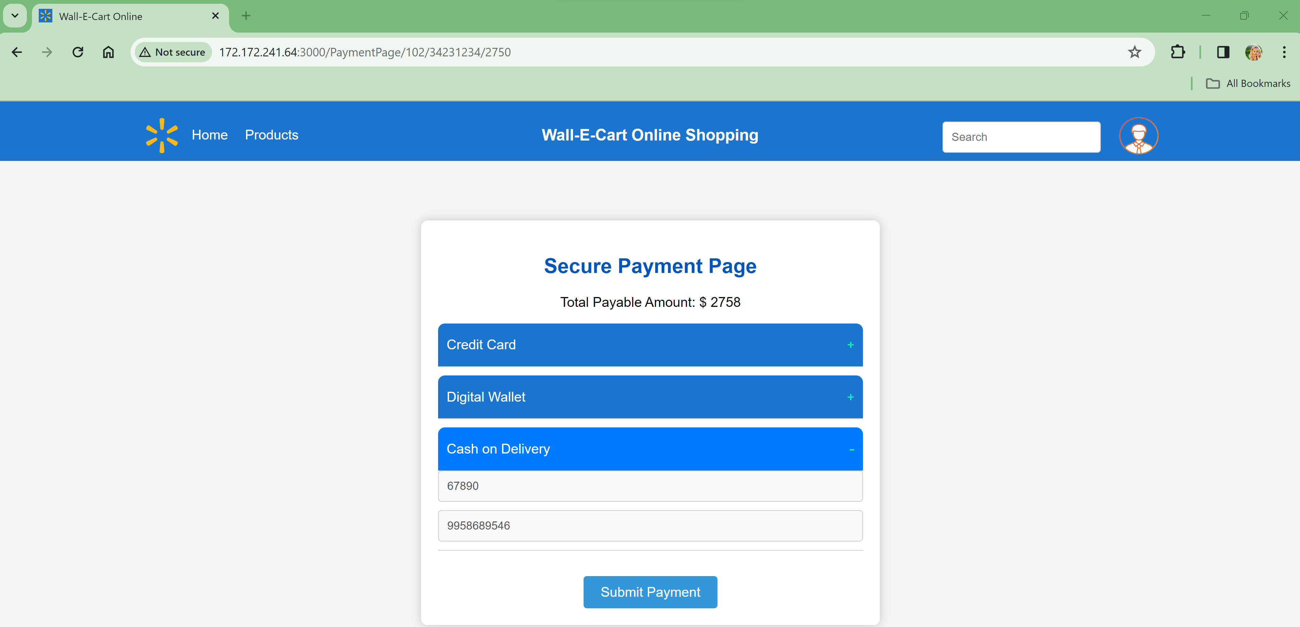
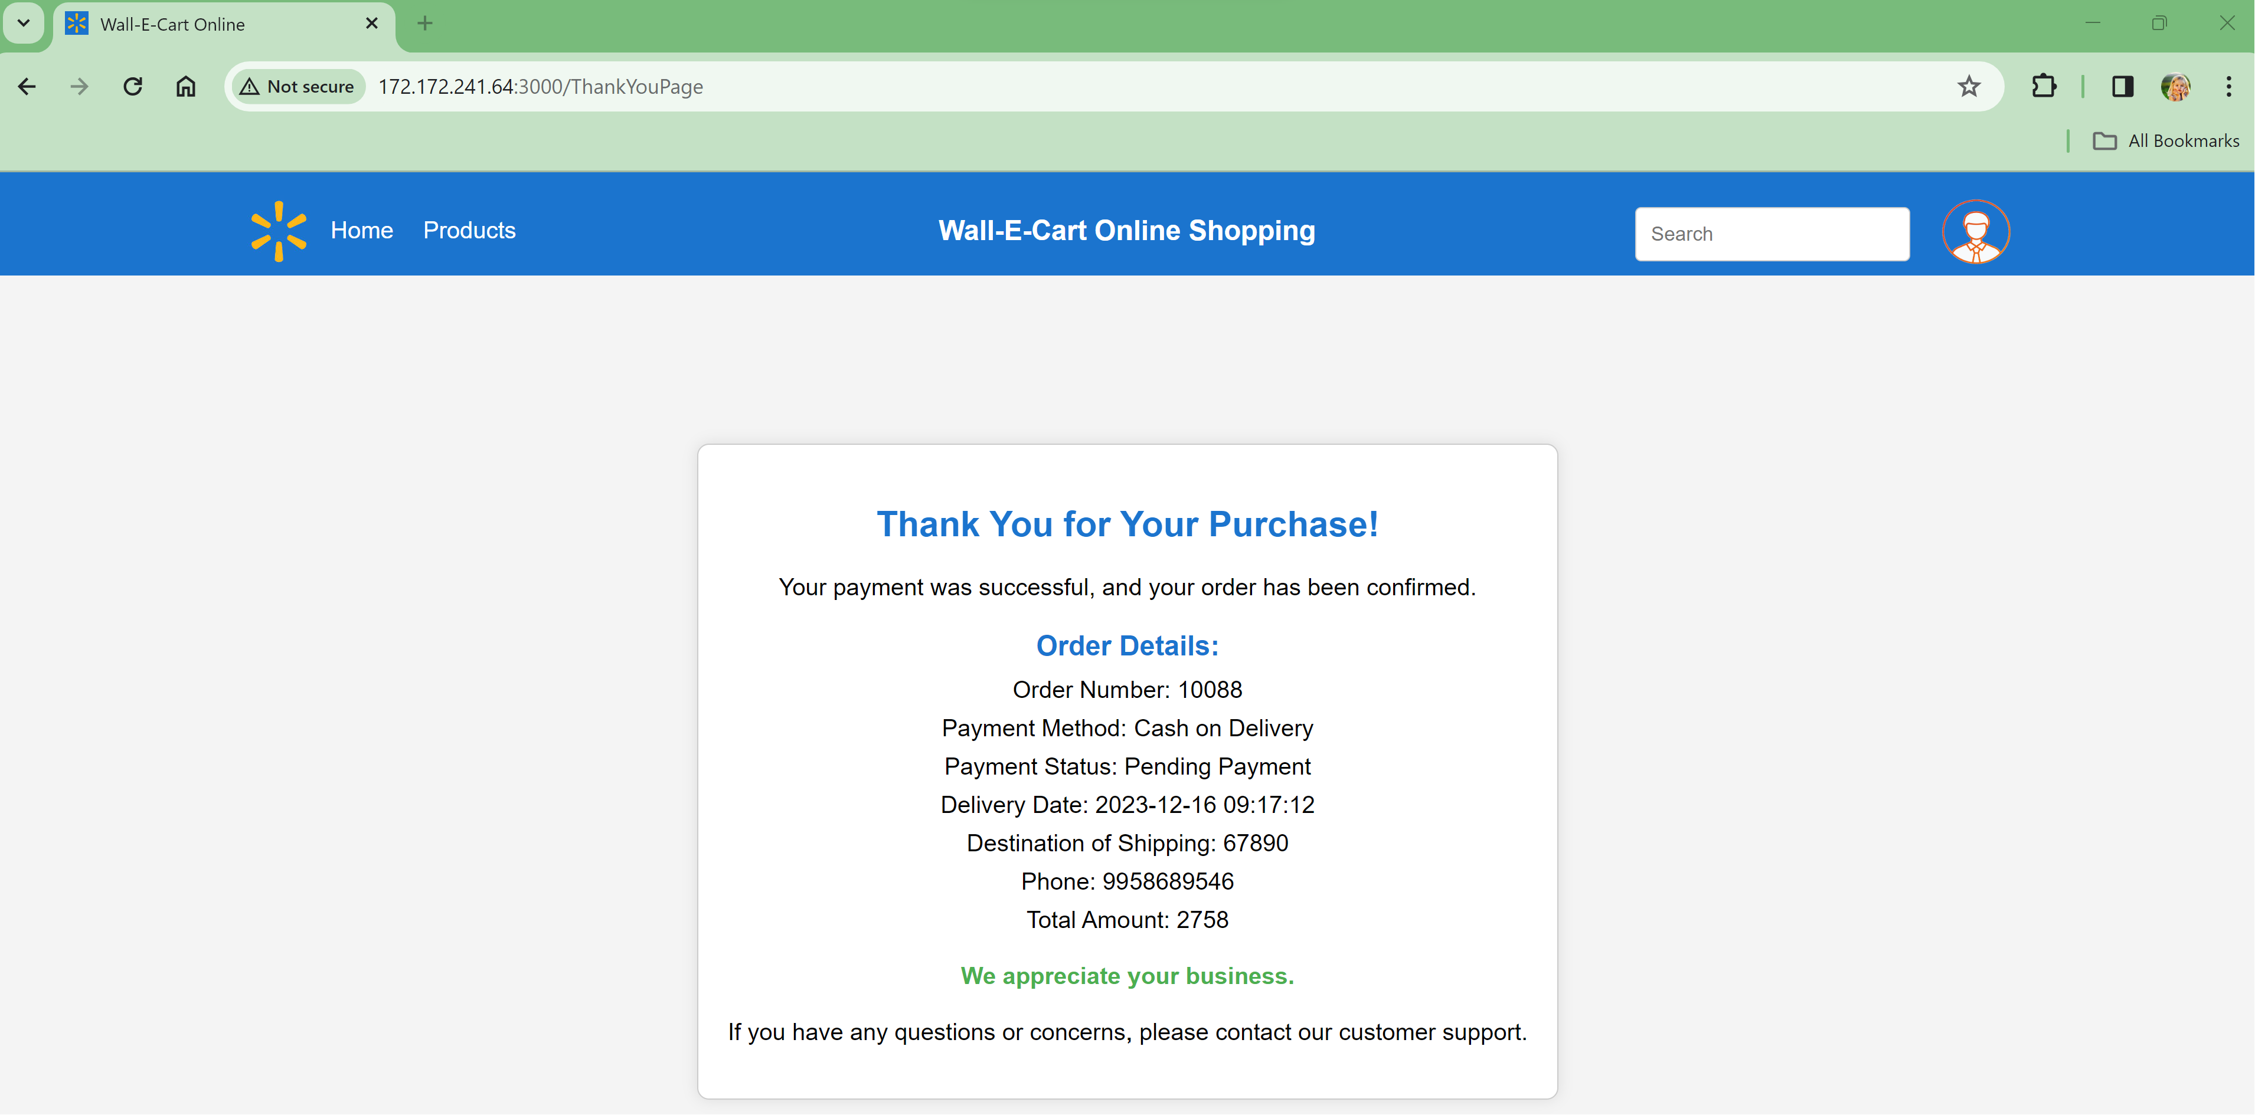
Solution Implementation - COD

Slide 13
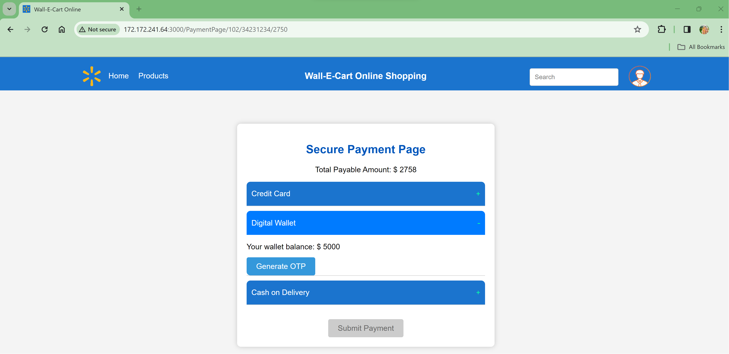
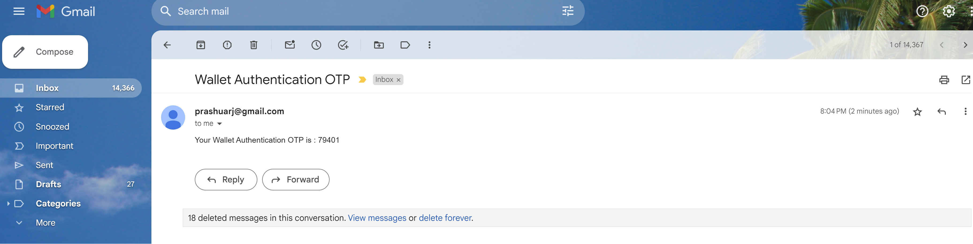
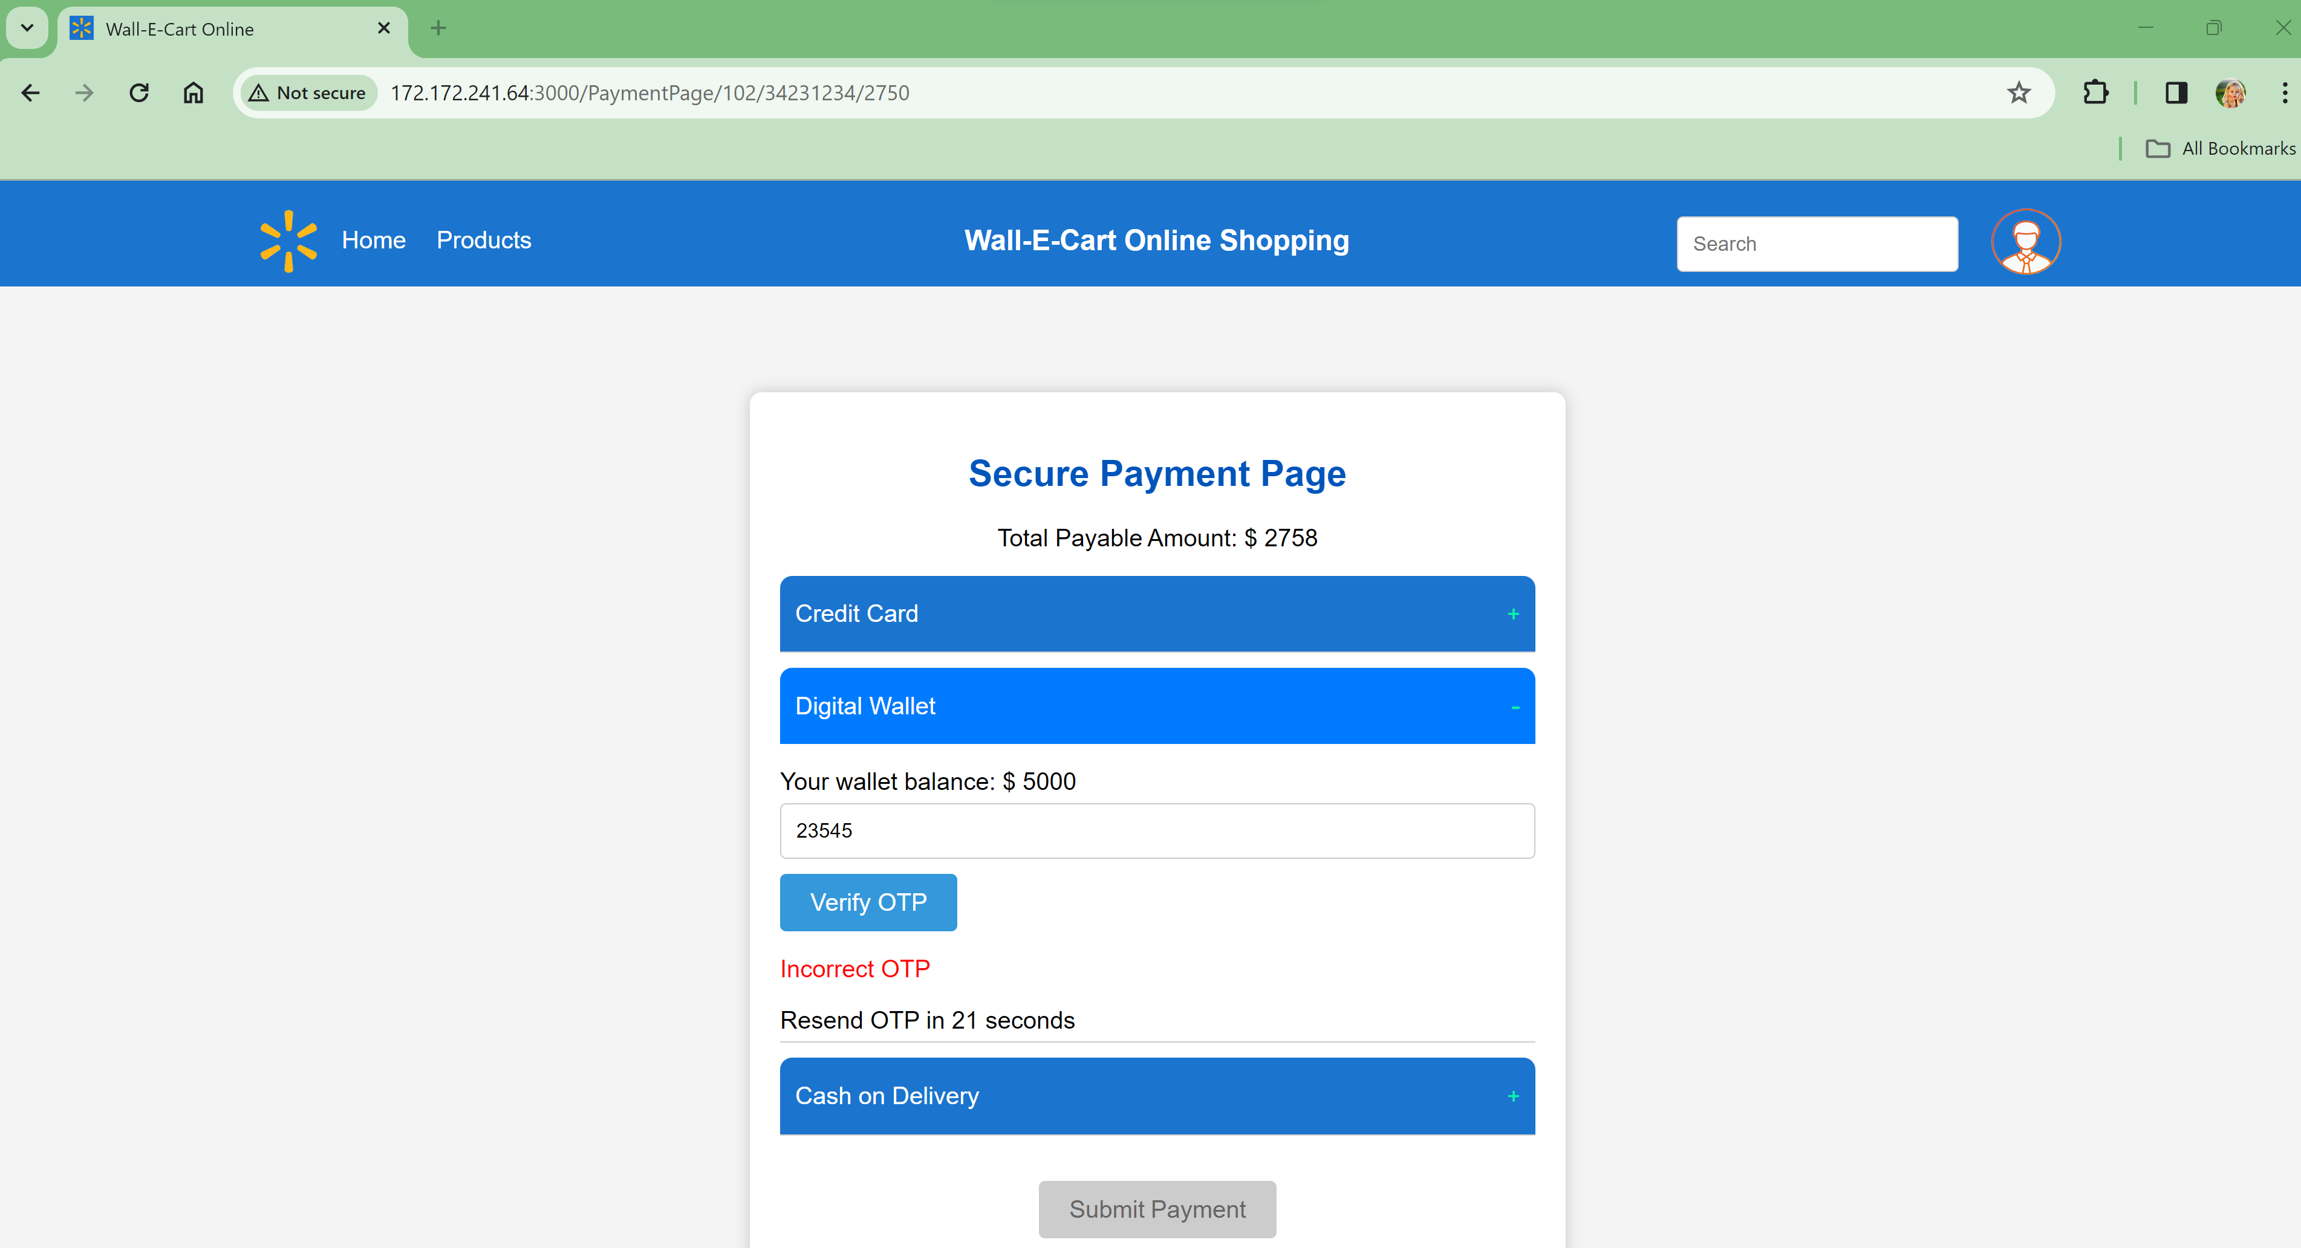
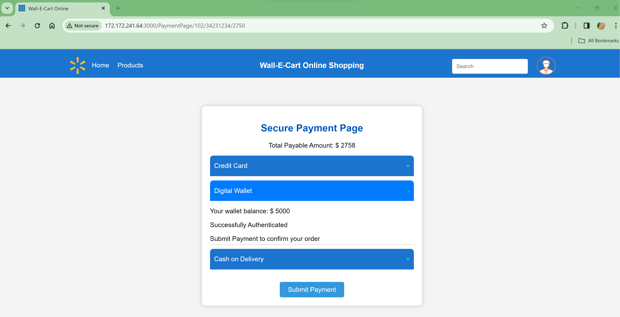
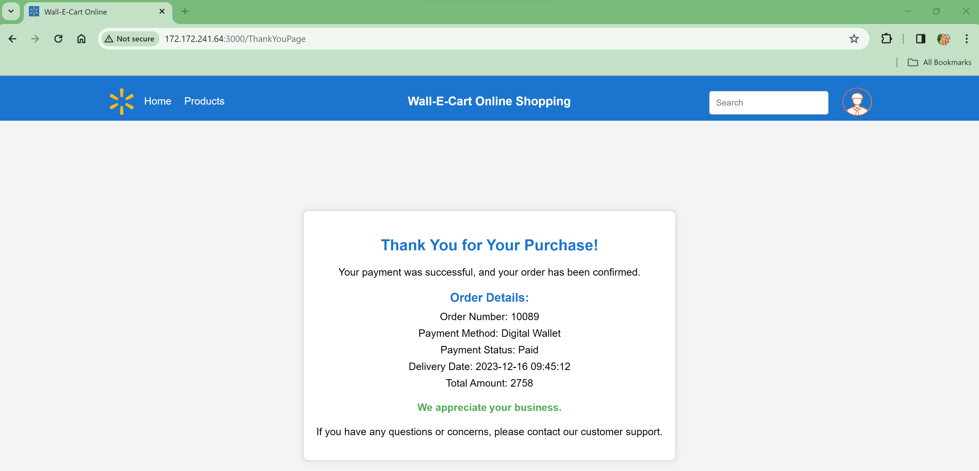
Solution Implementation – Digital Wallet

Slide 14
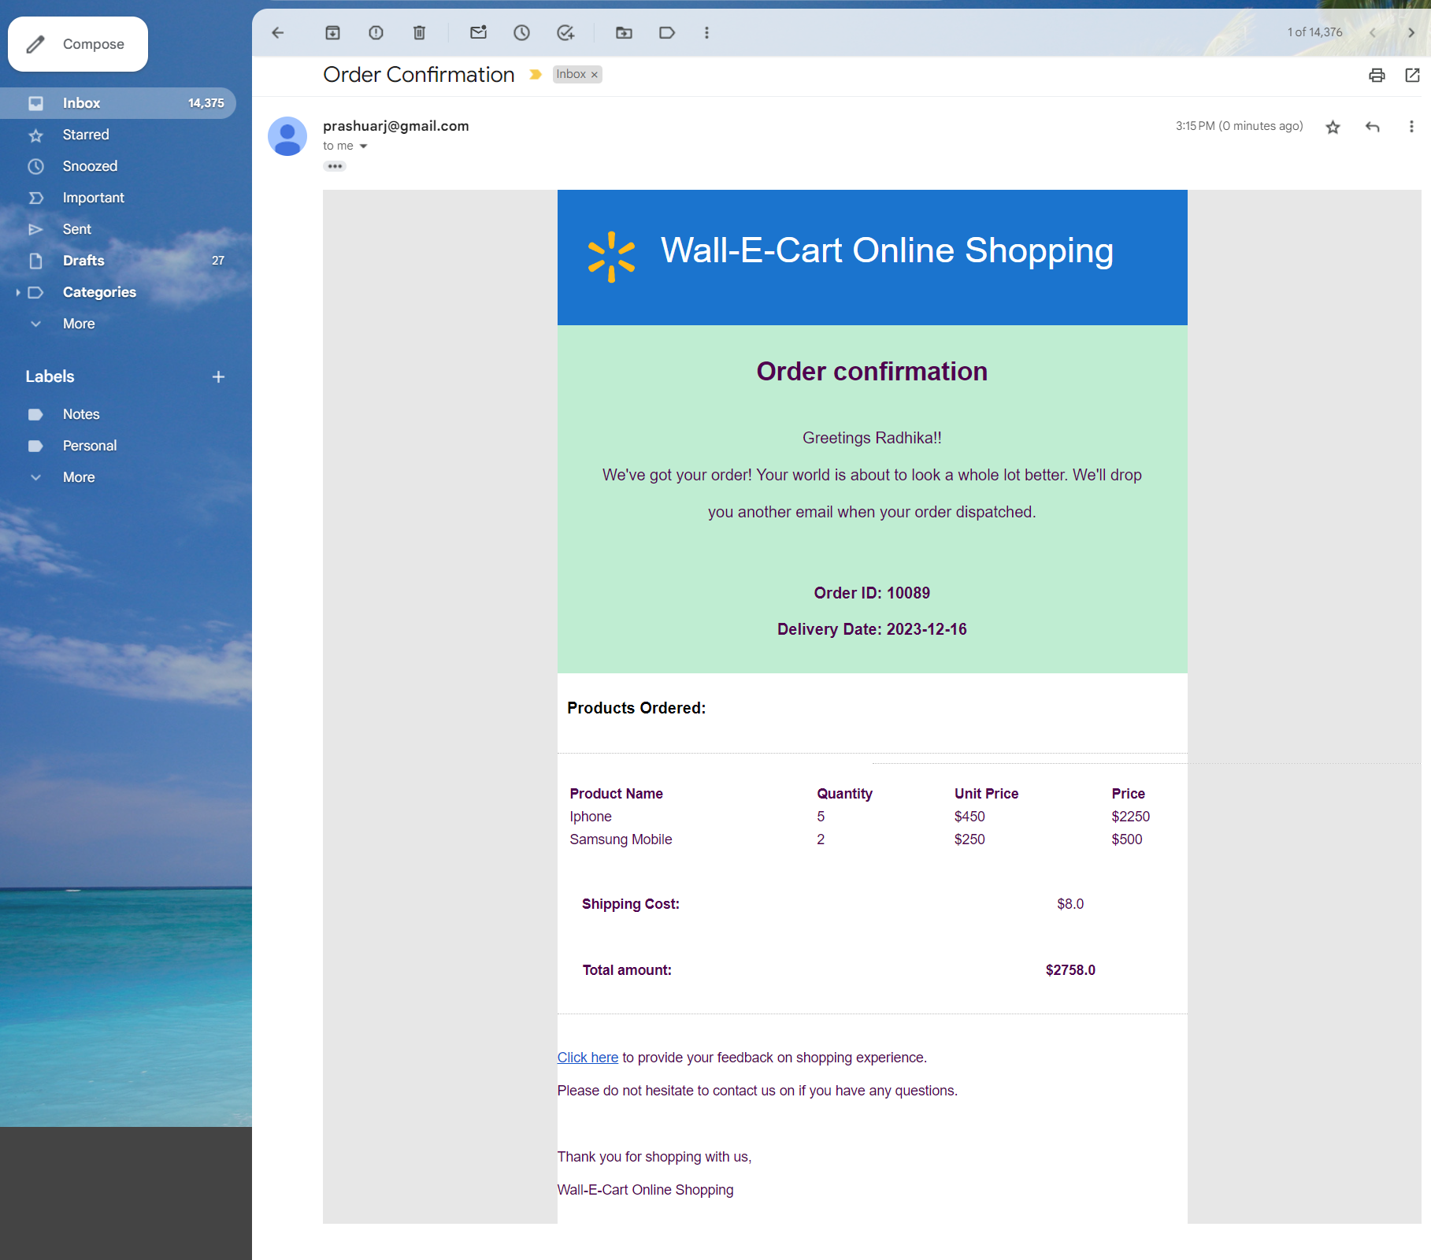
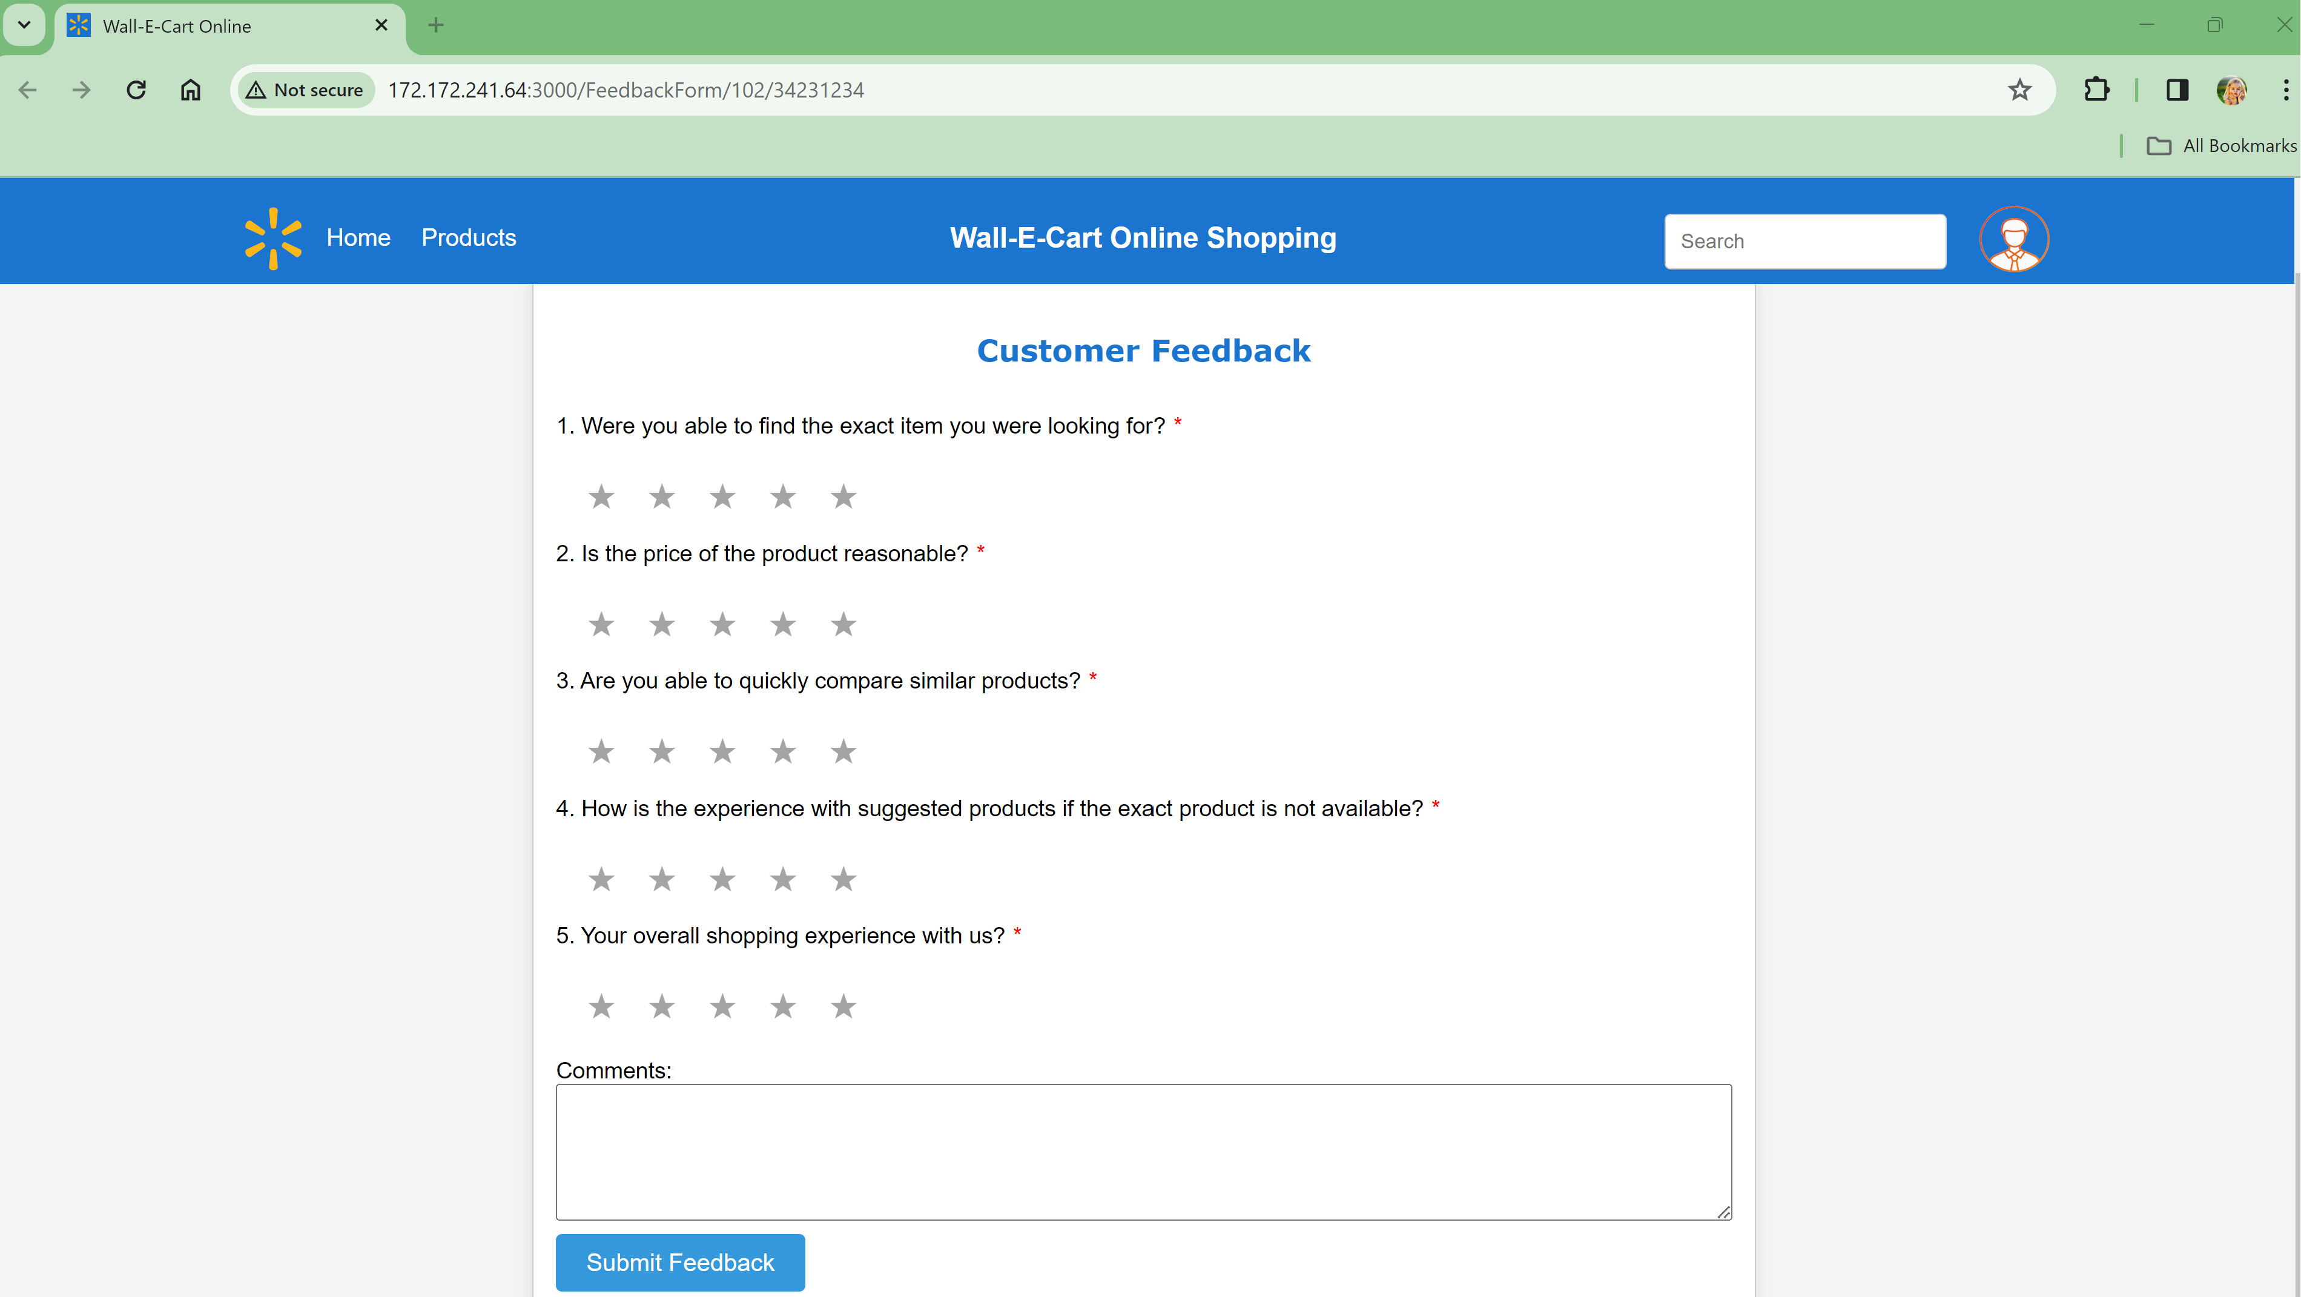
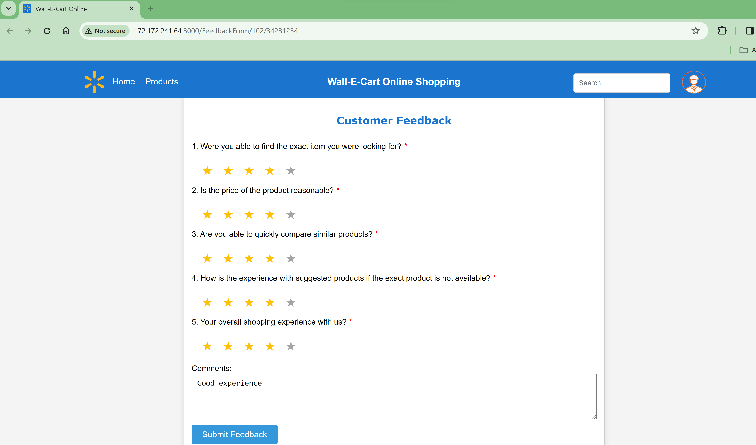
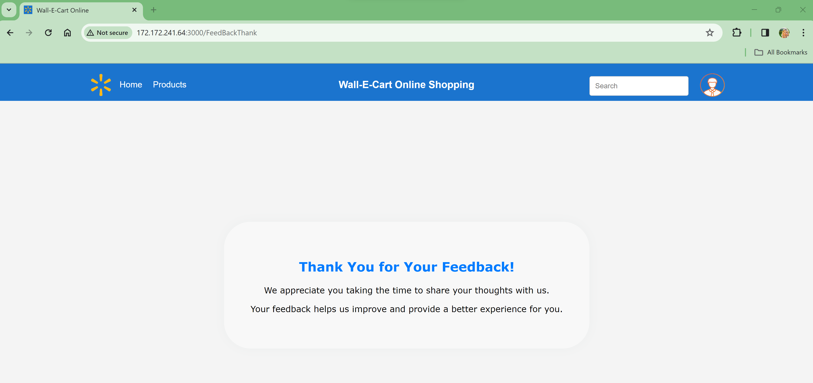
Solution Implementation – Email Notification & Shopping Feedback

Slide 15
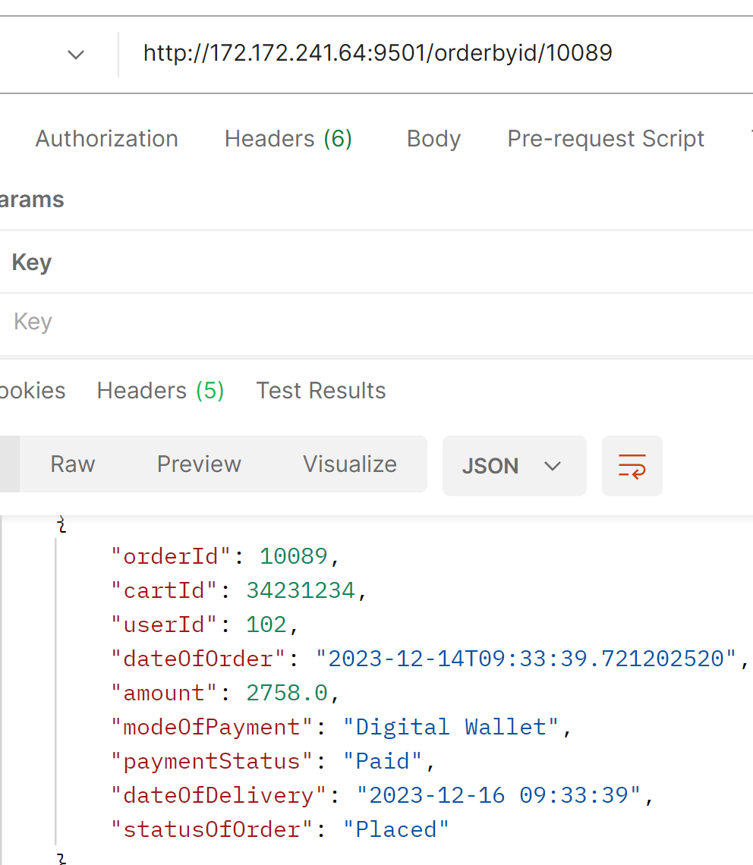
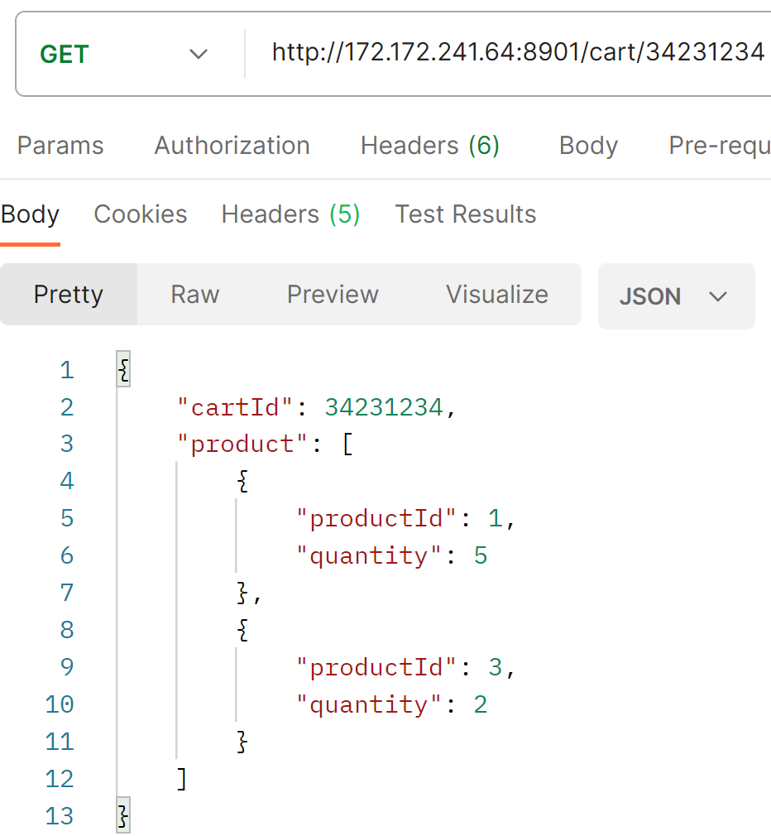
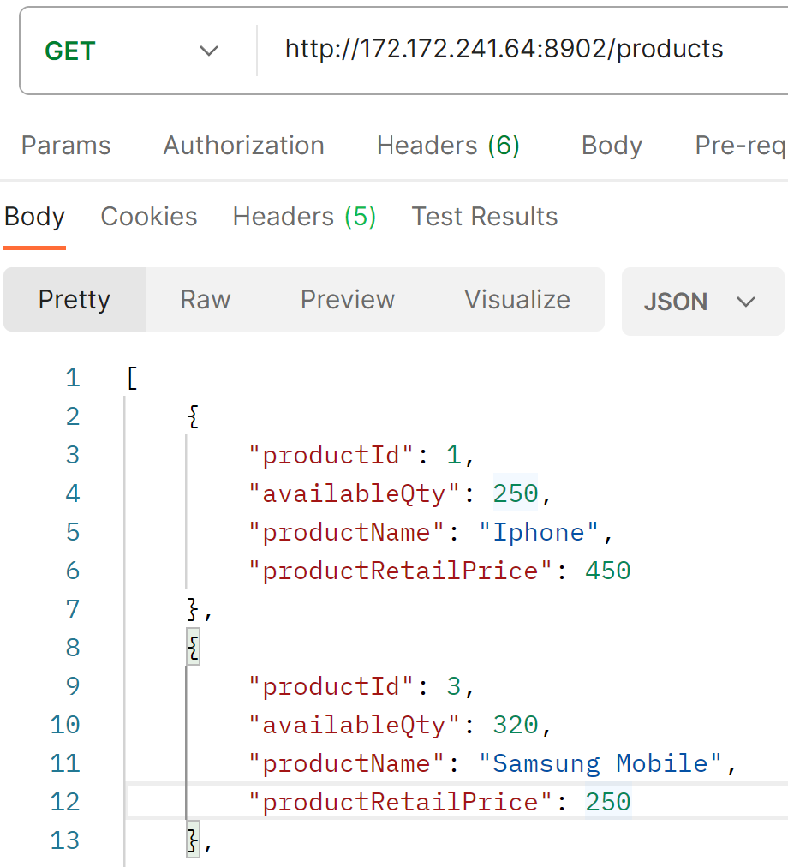
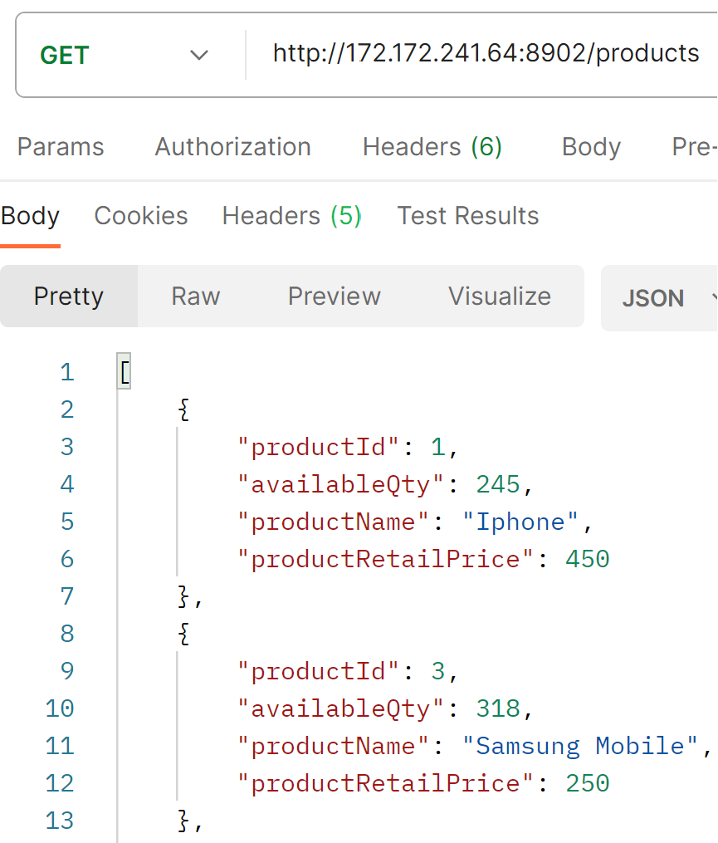
Solution Implementation – Order Confirmation & Inventory update
Order Details
Cart Details
Product Inventory
Before Purchase
After Purchase

Slide 16
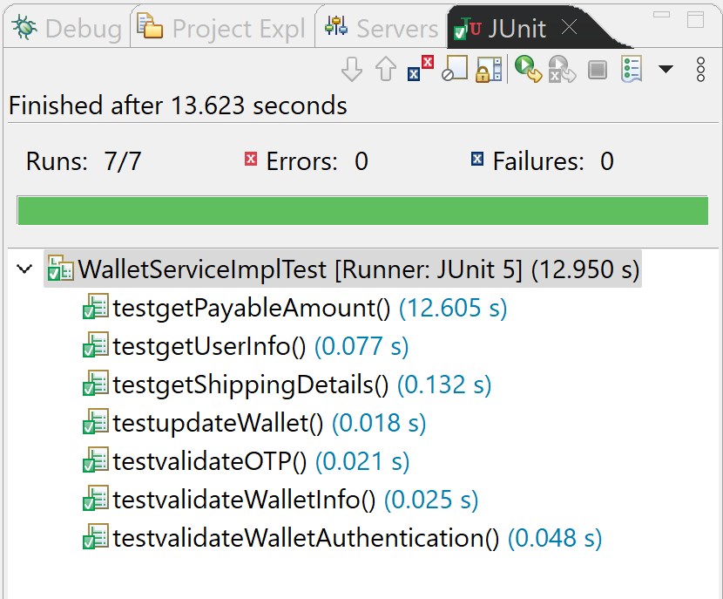
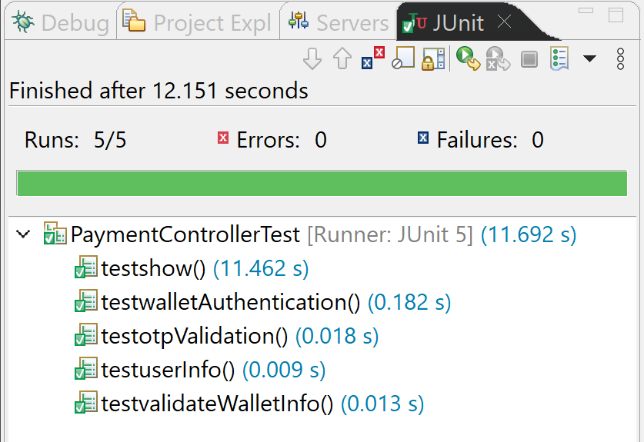
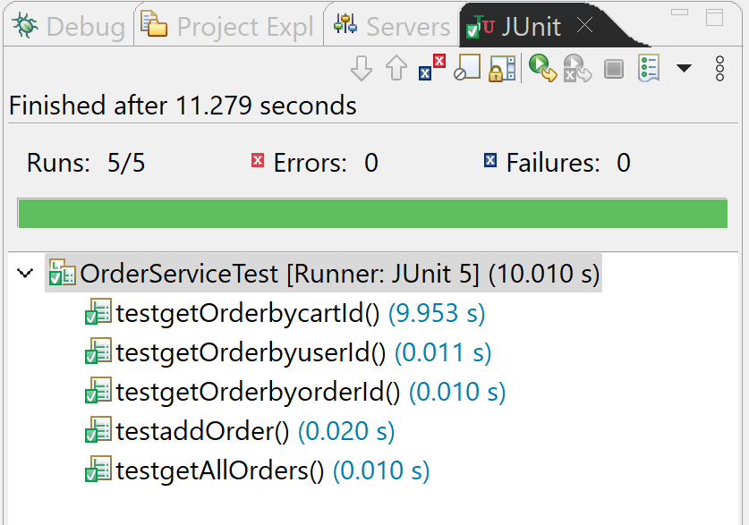
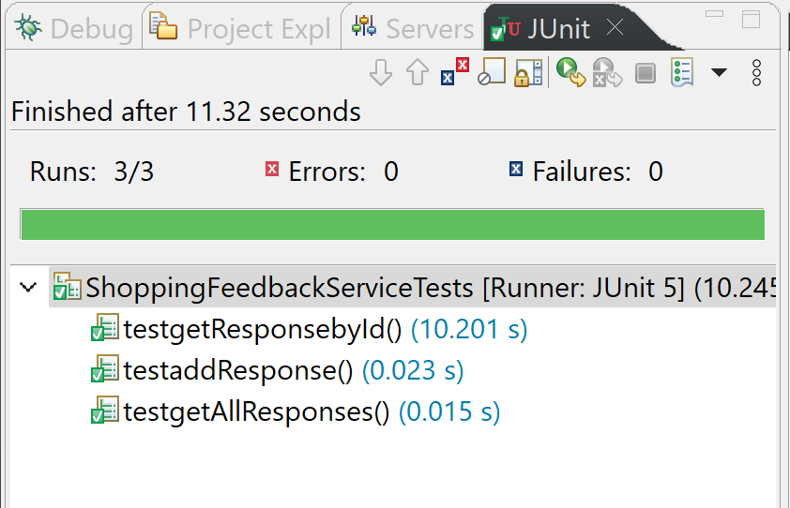
Mockito Junit Test cases for Micro Services
Created Junit Test cases for all critical functionalities in micro services

Slide 17
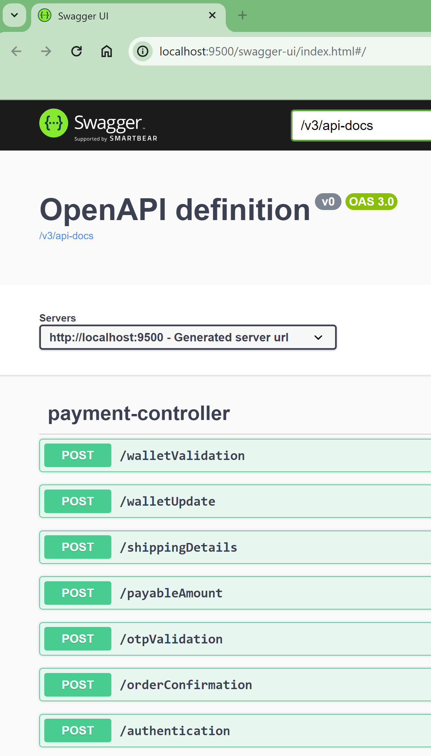
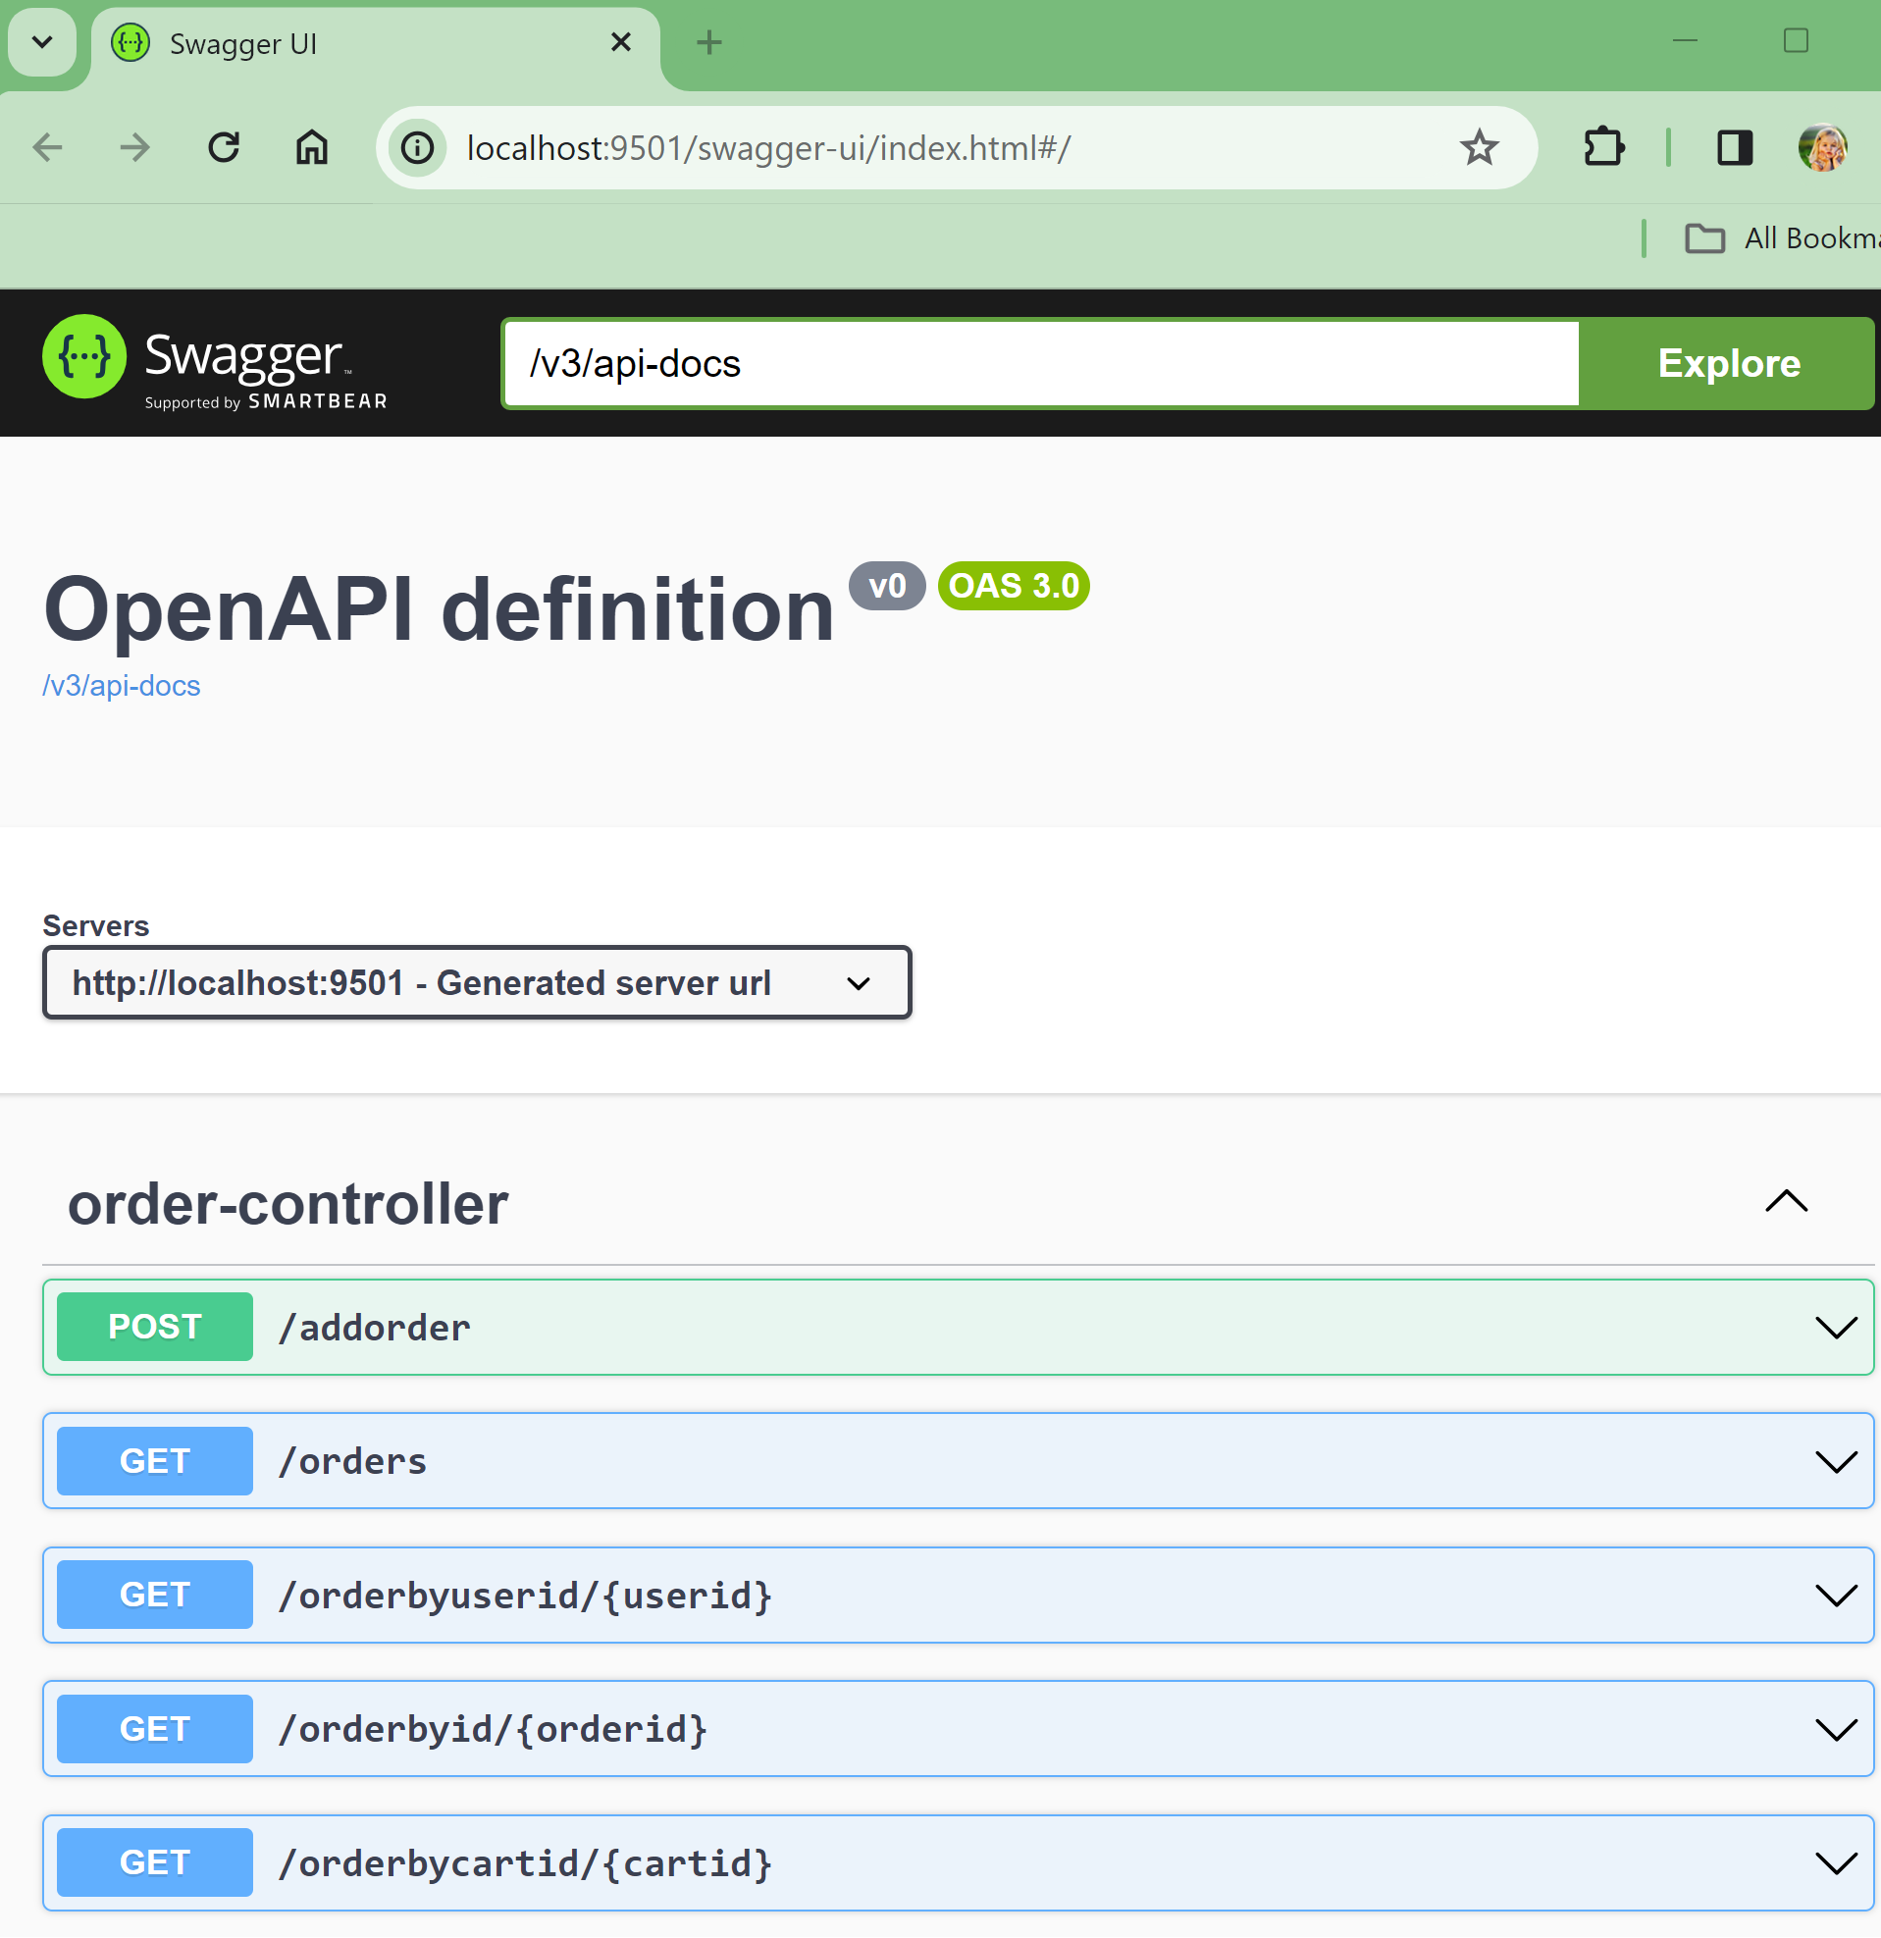
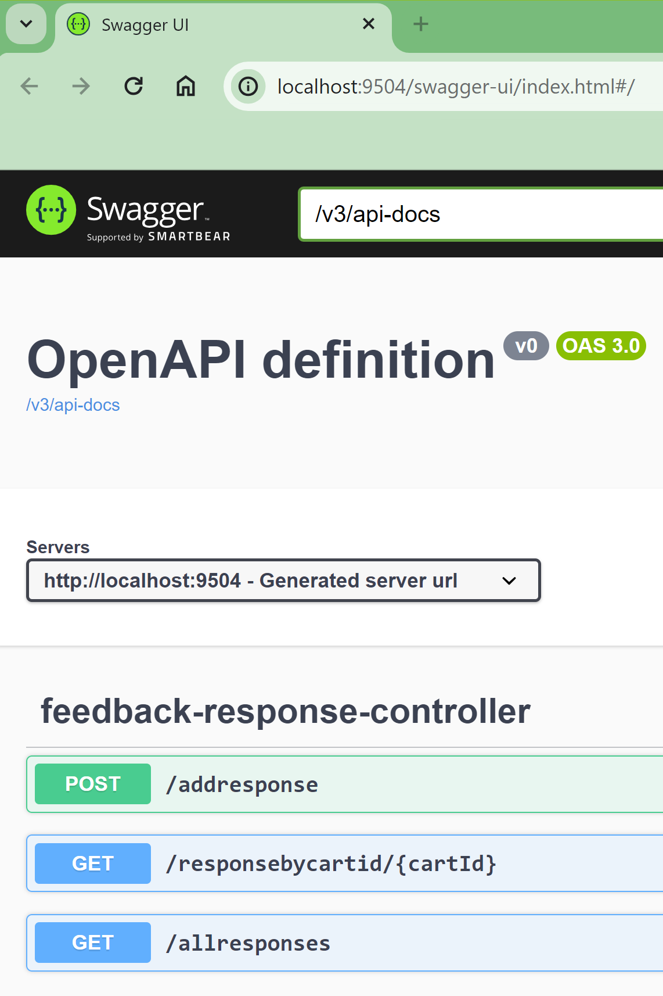
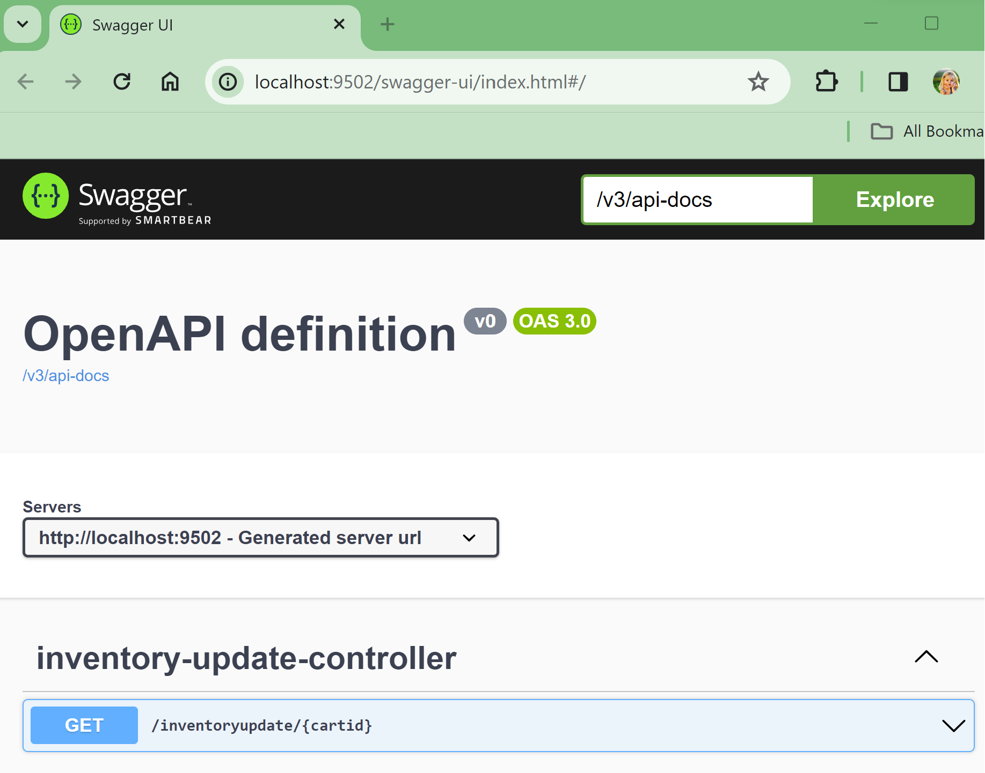
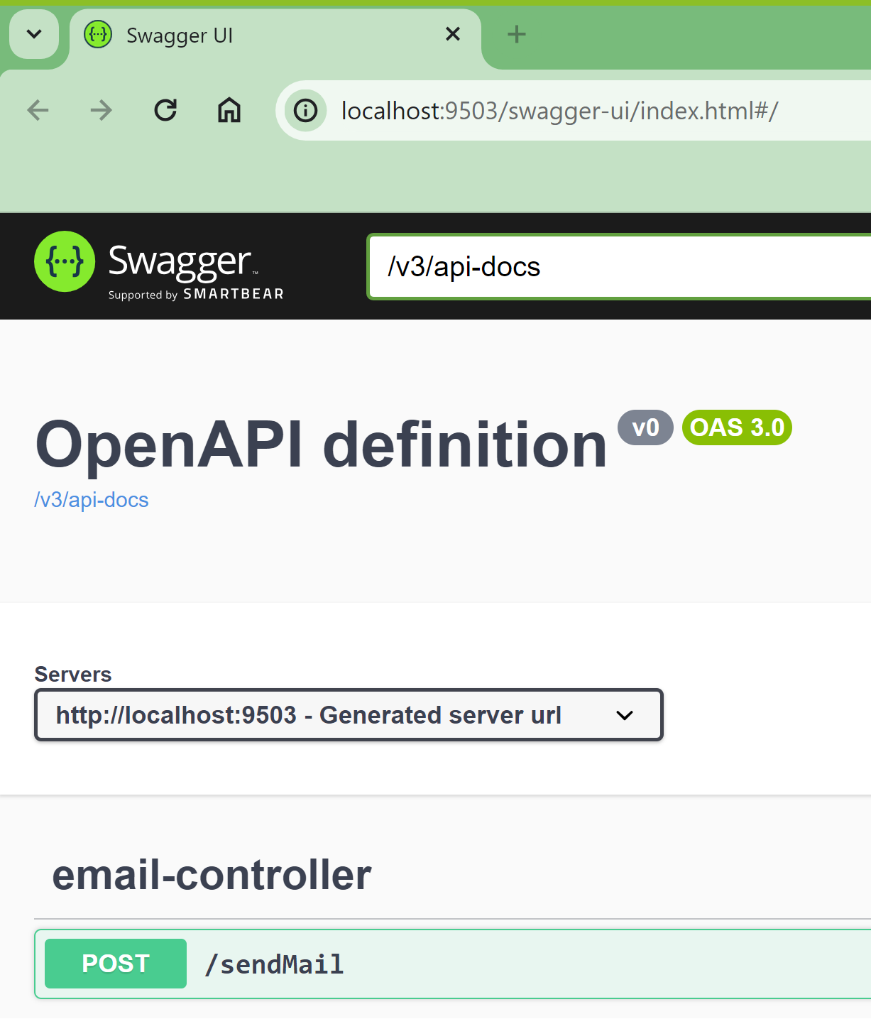
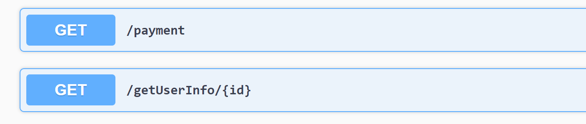
Swagger Documentation

Slide 18
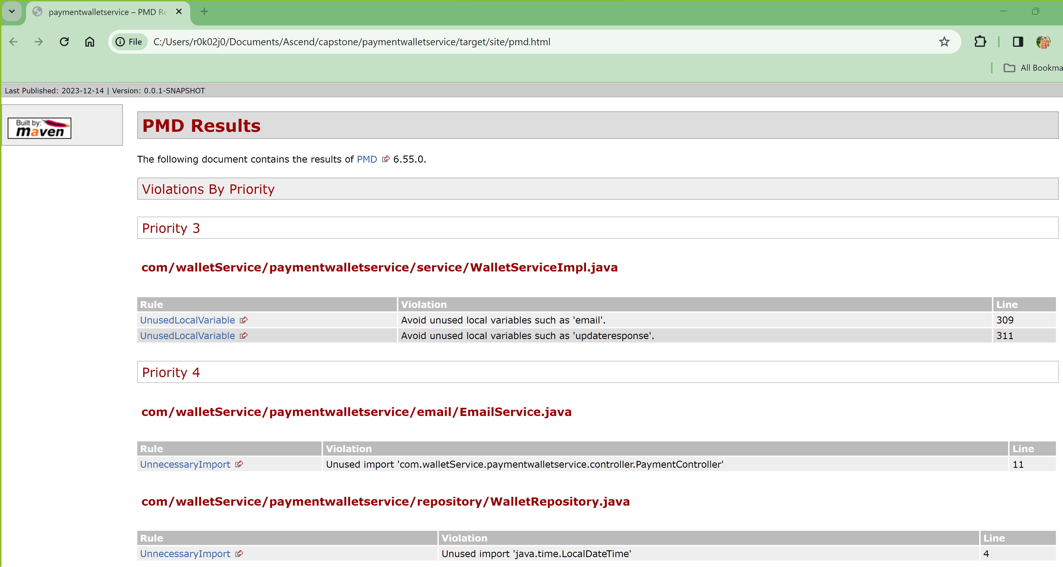
PMD Source code Analyzer – Before fixing errors

Slide 19
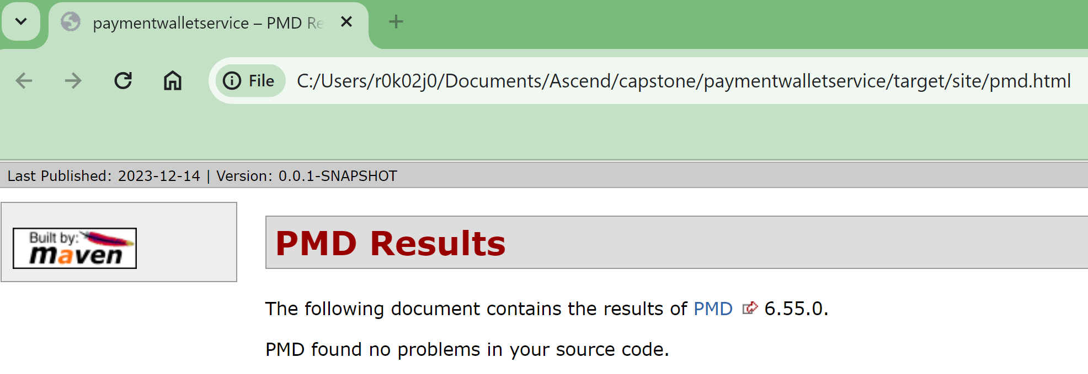
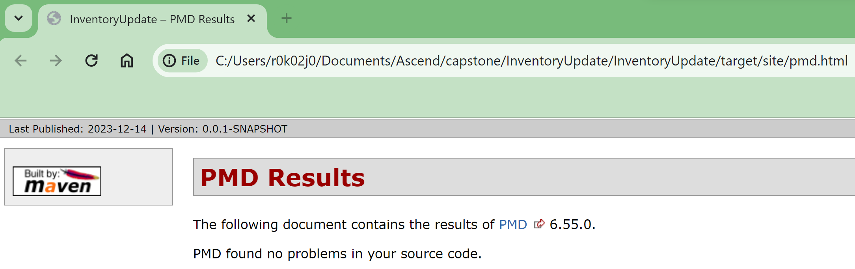
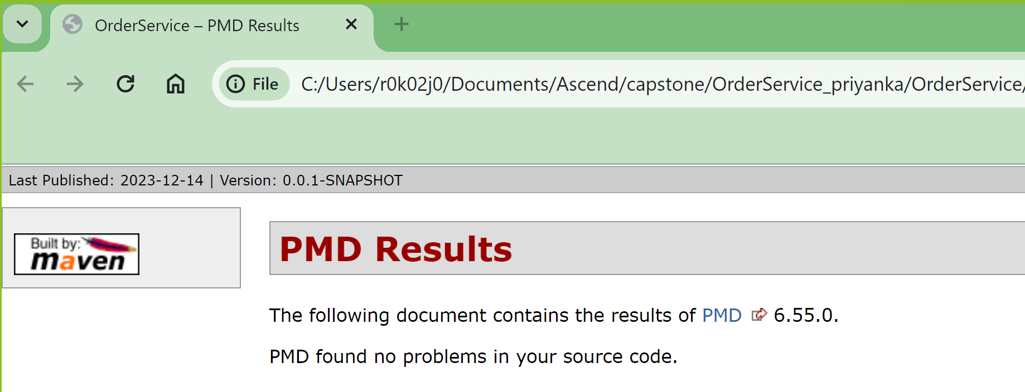
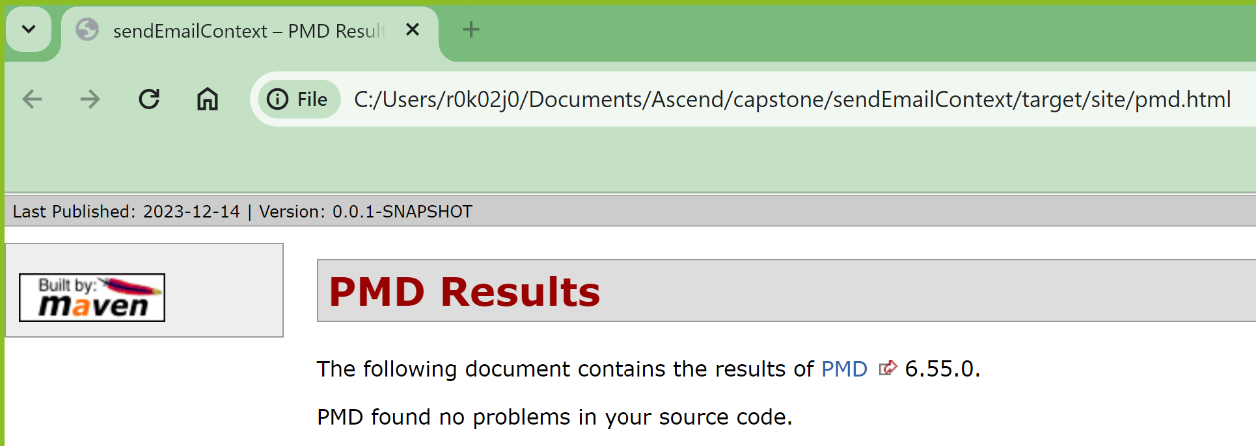
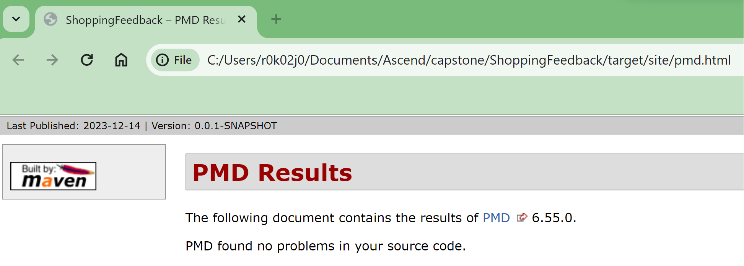
PMD Source code Analyzer – After fixing errors

Slide 20
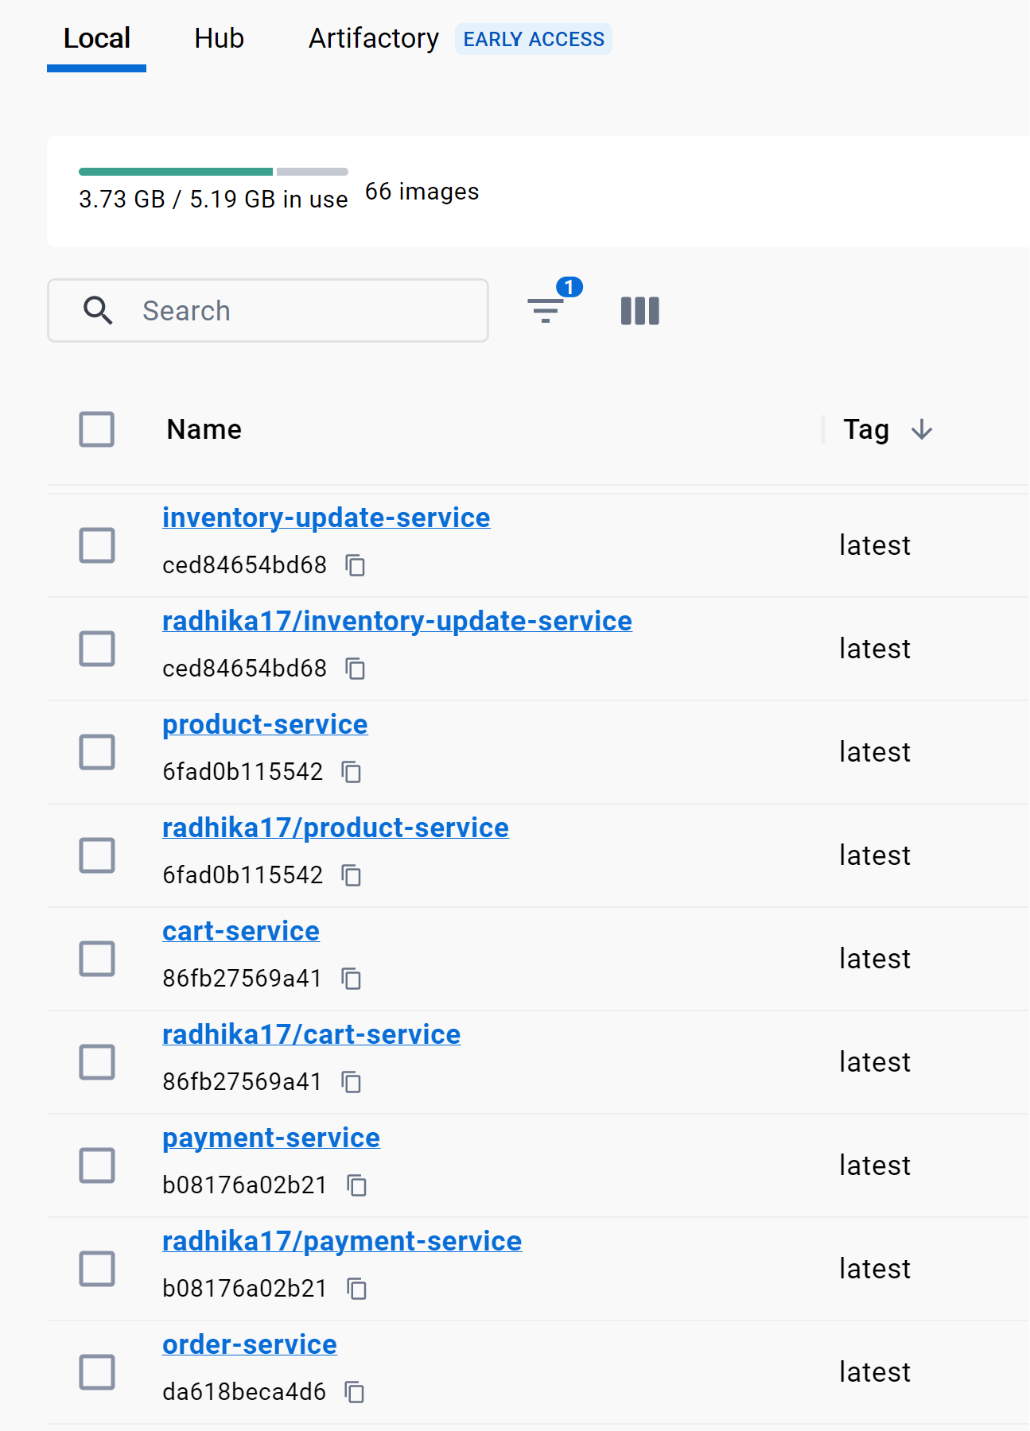
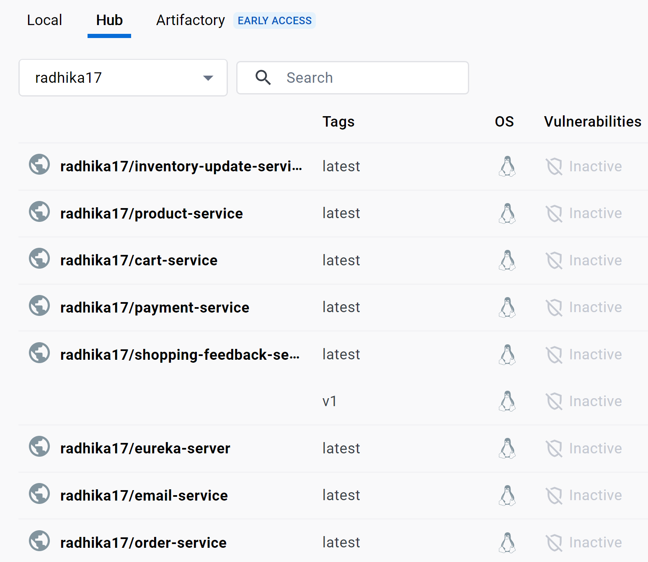
Dockerization of Micro Services
Created docker image for each Micro Service
Pushed docker image of Order Service to Hub
to make it accessible by other teams

Slide 21

DevOps Practice – CI/CD using Jenkins
Created Pipeline for each Micro Service to perform below steps continuously:
Cleanup Workspace
Checkout code from SCM (GitHub)
Build Application
Test Application
Code Quality Analysis using PMD
Build & Push Docker Image

Slide 22
Micro Services API Calls
Module | User Story | Task | End Points
Payment Service Module |  | onloading Payment Webpage | /payableAmount
 | DigitalWallet | onClick DigitalWallet | /walletValidation
 |  | onClick GenerateOTP | /walletAuthentication
 |  | onClick Verify | /otpValidation
 |  | onClick SubmitPayment | /orderConfirmation
 | CashOnDelivery | onClick CashOnDelivery | /cod
Order Service Module | Order Confirmation | order creation | /add
 |  | get Order Details | /getOrderbyId
 |  |  | /getOrderByUserId
 |  |  | /getOrderByCartId
Inventory Service Module | Inventory update | updateInventory | /inventoryUpdate/cartId
Email Service Module | Email Notification | emailNotification | /sendEmail
Shopping Service Module | ShoppingFeedBack | addFeedBack | /addRespone
 |  | getFeedBack | /allresponses
 |  |  | /responsebycartid/{cartId}

Slide 23
Reference
Module | GitHub Link | Jenkins | Dockerization | Swagger Link
PaymentService | https://github.com/walmart-2023-sep-ascend/Team06-Payment-module.git | http://localhost:9090/job/payment-service-automation/ | payment-service | http://localhost:9500/swagger-ui/index.html#/
OrderService | https://github.com/walmart-2023-sep-ascend/Team06-Order-Confirmation-Service.git | http://localhost:9090/job/order-confirmation-automation/ | order-service | http://localhost:9501/swagger-ui/index.html#/
InventoryupdateService | https://github.com/walmart-2023-sep-ascend/Team06-Inventory-Update.git | http://localhost:9090/job/inventory-update-automation/ | inventory-update-service | http://localhost:9502/swagger-ui/index.html#/
EmailNotiication | https://github.com/walmart-2023-sep-ascend/Team06-Email-Notification.git | http://localhost:9090/job/email-notification-automation/ | email-service | http://localhost:9503/swagger-ui/index.html#/
ShoppingFeedback | https://github.com/walmart-2023-sep-ascend/Team06-Shopping-Feedback-Service.git | http://localhost:9090/job/shopping-feedback-automation/ | shopping-feedback-service | http://localhost:9504/swagger-ui/index.html#/

Slide 24

Scrum/Agile Dashboard

Slide 25
Best practices followed during solution implementation
API calls through Openfeign client
Use of Lombok
Exception handling
Micro service architecture
Logger implementation
Swagger documentation
PMD source code analysis
Agile process by tracking status through jira dashboard
CI/CD pipeline process using Jenkins

Slide 26
Challenges & errors encountered during solution design
Other team’s dependency
Mock DB/API creation
Exceptions while integrating Micro services
Additional Query definition is required since @id annotation is not useful with Mongo DB
@Sequencegenerator annotation is not working in Mongo DB to generate unique order id in sequence hence we had to use Mongo Operations Incrementor logic to achieve it
Faced challenges while integrating HTML page as body of the email notification
Docker push through Jenkins
Cloud Deployment

Slide 27
Learnings & enhancements
We learnt to work with Mongo Atlas environment
Mongo DB and Spring-boot integration
Micro Services with Rest API to achieve each business logic
Micro Services integration with help of Eureka Naming server
MVC structure for an application
Learnt how to create webpages with React and how to integrate with backend
Dockerization – creating docker image, pushing it to docker hub, pulling it from hub and running in cloud
Jenkins – CI/CD process by creating pipelines for each Microservice
Cloud Deployment – creating virtual Network, virtual machine, resource group and deploying application in cloud

Slide 28
What extra has been implemented in the Capstone Project
We have created additional Cart and Product Microservices to mockup the dependency from team 3 and team 4
Team has additionally added search bar in UI page
Team has additionally added user profile in UI page
We have enabled OTP based validation while making payment through DigitalWallet
User-Friendly Email notification once order is confirmed
Making user to provide comments as mandatory if the overall shopping experience rating is less than 3

Slide 29
Team 7 – Shipping and Delivery

Slide 30

CLASS DIAGRAM – Team 07

Slide 31




Solution Implementation – ADMIN UI PAGE
View Shipping Rules:
To add new rules:
Update Existing Rules:

Slide 32



Solution Implementation – ADMIN LOGIC

Slide 33


Solution Implementation – Shipping Service Logic
CalculateShipment() service provides the Data to the Item Page
CalculateShipping() service provides the optimal delivery days and Shipping cost for each cart to Payment Service

Slide 34


Solution Implementation – Shipping Service Logic
Ordercreate() Service send mail notification once the order has been created.

Slide 35


Solution Implementation – Shipping Service Logic
Created function to remind User if the Item is added to CART but not paid.
Final mail once the Order has been successfully received
OrderInfoController () will send the order status till order has been received.

Slide 36



JUNIT TEST CASE

Slide 37


JENKINS PIPELINE SETUP – FRONTEND & BACKEND

Slide 38


DOCKERIZATION
Created Docker Image for shipping micro-service
Docker Image Pushed to Hub

Slide 39
Shipping Service Details:

Slide 40

Scrum/Agile Dashboard

Slide 41
Shipping & Delivery Reference:

Slide 42
Challenges & errors encountered during solution design
Other team’s dependency
Mock DB/API creation
Exceptions while integrating Micro services
Unable to PUSH the docker thru JENKINS due to authentication issue.
Cloud Deployment

Slide 43
Learnings & enhancements
Analyzed to implement the solution to integrate “Ecrion” Software to generate PDF during Order creation and real time tracking updates.
Learned to create Mock Data for testing API’s.
Learnt Mongo DB Atlas
Implementing Kafka
Need to implement a logic to find shortest route based on geo location and send to the 3rd party delivery Partners for Last mile delivery.
Need to generate report based on the orders in scheduled manner to provide discounts to users and remind him if this subscribed order, Also based on geo location suggest the mostly ordered item availability to nearest stores with price discounts.

Slide 44
What extra has been implemented in the Capstone Project
API has been created in addition to display the Shipping method in Item Page
To track the real time Order status KAFKA Topic will be monitored and status will be updated. This is developed instead of creating a stand-alone program to update the status on scheduled manner.
Also developed notification API to send alert once the order is created including Order ID.

Slide 45
Task Tracker – Team - 07
1. Requirement Gathering Shipping and Delivery --> Ramakrishnan S
1.1 Architecture --> Ramakrishnan S/ Rajeshkumar Mohankumar
1.2 Group Integration (Team 06/ Team 07) --> Rajeshkumar Mohankumar
1.3 Class Diagram --> Ramakrishnan S
1.4 Sequence Diagram --> Ramakrishnan S
2. ADMIN UI Page - Gunasekar M
3. ADMIN SERVICE:
PRODUCT CONTROLLER (CRUD) --> Nagendrakumar Ranga
LOCATION RULE --> Nagendrakumar Ranga
4. User Service:
CART CONTROLLER --> Rajeshkumar Mohankumar
ITEM PAGE CONTROLLER --> Sharmili Mahesh
ORDER UPDATE CONTROLLER --> Santhana Sowbogya Sh S
ORDER TRACKING CONTROLLER --> Rajeshkumar Mohankumar
Implementing Kafka ---> Rajeshkumar Mohankumar
CART Reminder --> RajeshKumar Mohankumar
5. CI/CD Pipeline intergration. --> Nagendrakumar Ranga /Gunasekar M
6. Dockerization (Frontend/Backend) ---> Nagendrakumar Ranga /Gunasekar M
7. Exceptions Added ---> Sharmili Mahesh/Santhana Sowbogya Sh S
8. Test Data Mocking --> Ramakrishnan S
9. UI Page & Backend Intergration - Gunasekar/Nagendrakumar R
10.Team 06/Team 07 code Intergration - Rajeshkumar Mohankumar / Nagendrakumar Ranga
11. Cloud Deployment ---> Nagendrakumar / Rajeshkumar
12. PPT ---> Ramakrishnan S

Slide 46
Thank You

